Slide 1
AMSACON
Amplified.
Future physicians:
Welcome to this year's conference.

Slide 2
Equity in medicine.
Change doesn’t happen in a silo. Change happens when we come together as inspired individuals and organizations from all walks of life, from across disciplines — united by a desire for change.

Slide 3
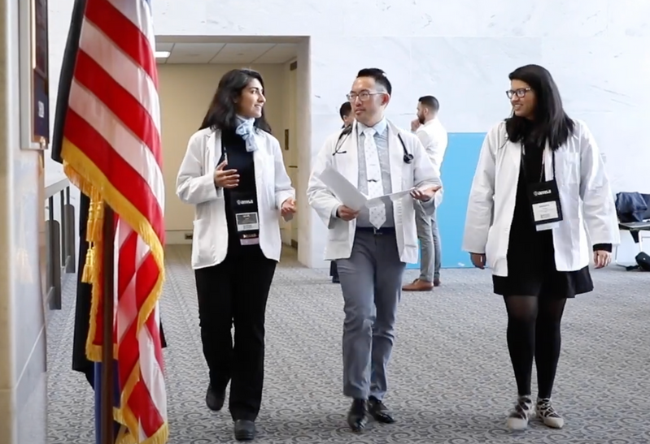
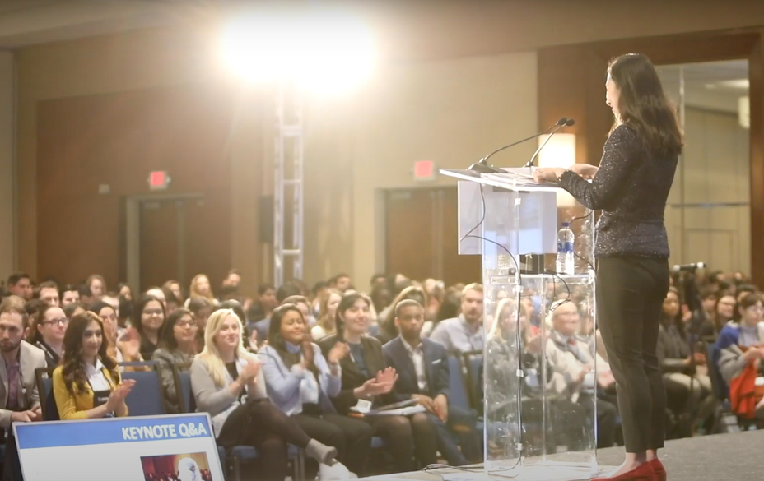
For over 70 years, AMSA has convened medical students, physicians and innovators from around the globe for a single purpose:
to empower future physicians to become leaders — ushers of a more equitable realm of medicine.
This is AMSA’s Annual Convention.

Slide 4
As we started planning this year's convention —
we took a step back. And did some thinking.

Slide 5
The way we see it —
We're future physicians. We chose this path as we want to make a difference in the world. And to do this today – to ensure that we make impact — we need to be bold. Audacious. We need to dare.
Dare ourselves to imagine a better future. Dare the world around us to be more accepting, welcoming and inclusive. Dare to try new things. And — perhaps most of all — dare to have some fun while doing it.
And so we are.
Let's dare.

Slide 6
This year, we're tuning things up by joining forces with like-minded organizations + allies.

Slide 7
INTRODUCING
A 3-day hive of learning, advocacy + connection.
By partnering with organizations with a shared vision — we are folding in more voices, ideas + resources that all serve up to one goal: To empower you — the next generation of physicians — to make change in health care.
Think of it as a kind of super-convention — AMSACon expanded. More voices. More ideas. More change. More fun.
Will you join us?

Slide 8
What to expect?
to LEARN
to ADVOCATE
from medical experts, leaders + movement-makers—through inspired keynotes, hands-on SIM-training and much more.
learn to take that issue that keeps you up at night and and take it to Congress. Literally.
to ADVANCE
to NETWORK
develop professionally—present research via a poster session, work on your CV, sharpen your communication skills + more.
in a really authentic way. Meet health care trailablazers and like-minded peers in an inspired, inclusive environment.

Slide 9
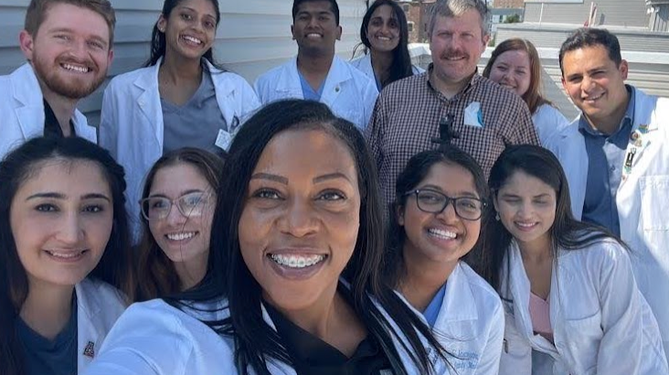
This slide attempts to convey the spirit and energy this conference brings.
(But it is, after all, a slide.)
Come see for yourself

Slide 10
The main scoop.
When?
June 15-17, 2023
Where?
Phoenix, AZ
Who?
Future Physicians
Physicians
Experts
Trailblazers
Innovators

Slide 11
How to prepare?
STEP 1:
Register to attend
Funding options - apply for a scholarship or ask school for funding
STEP 2:
Consider submitting a poster — deadline is April 21
Sign up for Advocacy Day if this is your thing
Register your team for the National SIM Challenge by April 14
Nominate a changemaker for a National Award by April 17

Slide 12
Only one last question.
Do you dare?
We think yes. Join us!
futurephysiciansforchange.org

