Slide 1
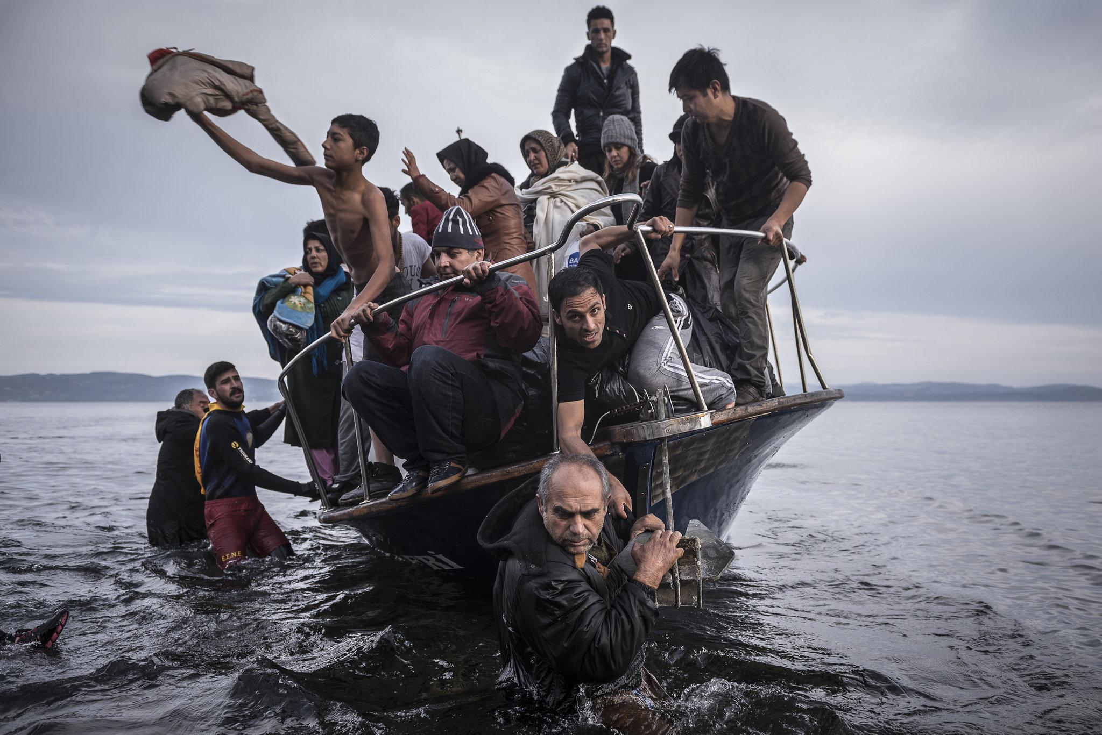

AMSA Refugee Advocacy
AMSA Advocacy
Karin Zikra

Slide 2
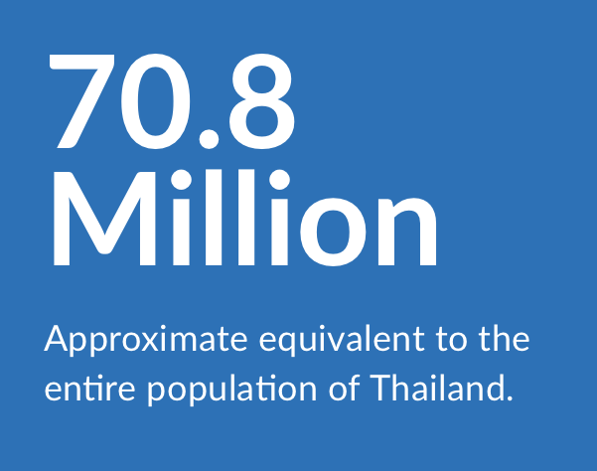
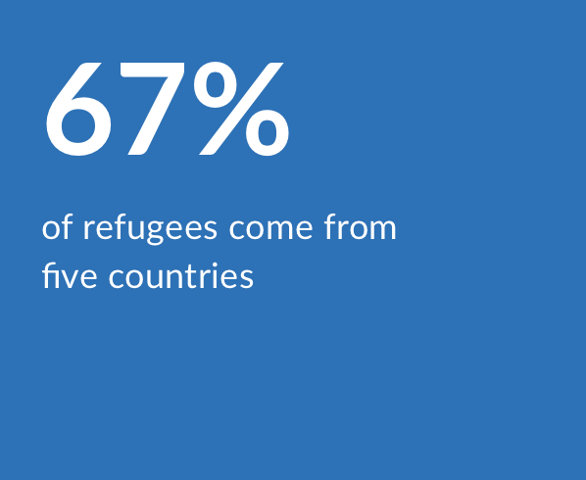
What is a Refugee?
A person who has been forced to flee his or her country because of persecution, war or violence→ Cannot return home due to fear of persecution
Leading causes: war and ethnic, tribal and religious violence
Two-thirds come from: Syria, Afghanistan, South Sudan, Myanmar and Somalia

Slide 3
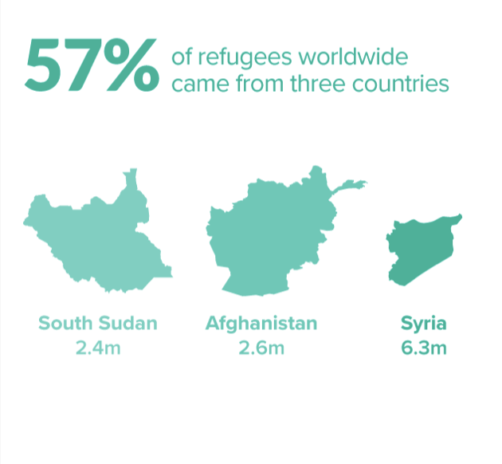
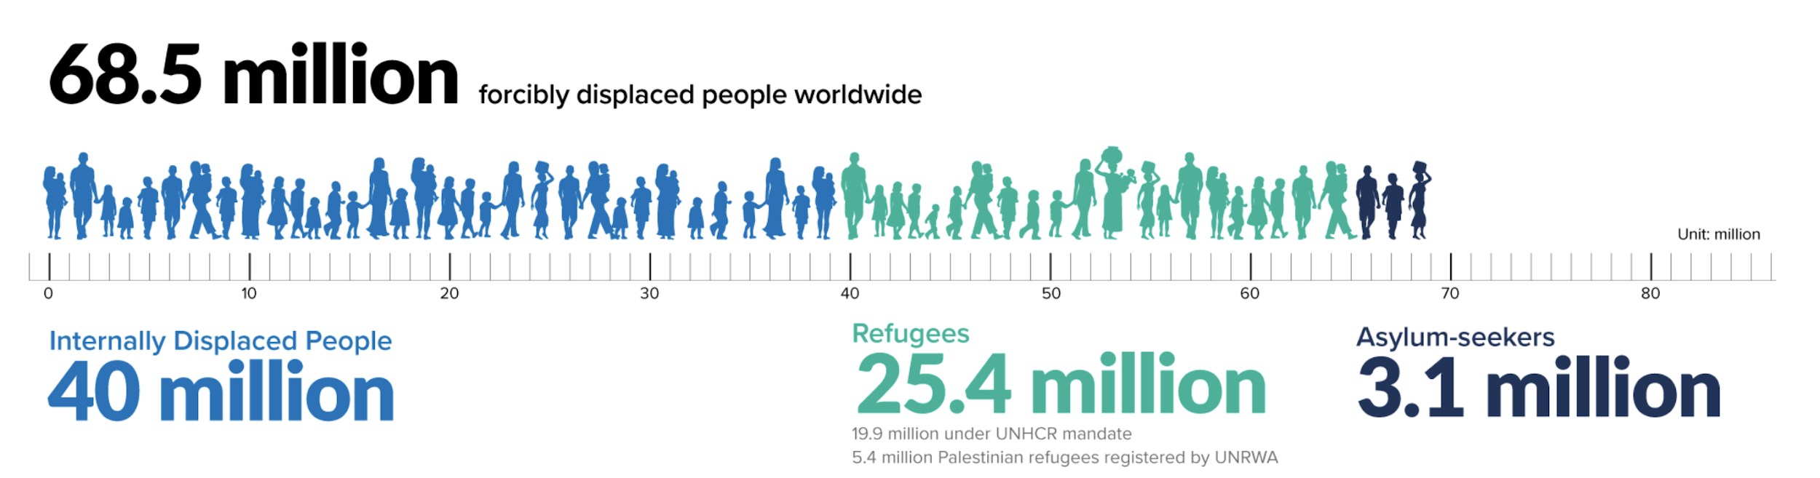
Refugee Stats Overview
Out of the more than 22 million refugees in the world, less than one percent are considered for resettlement worldwide
There was an increase of 2.3 million people the past year
Within their population, more than half of the refugees are under the age of 18

Slide 4
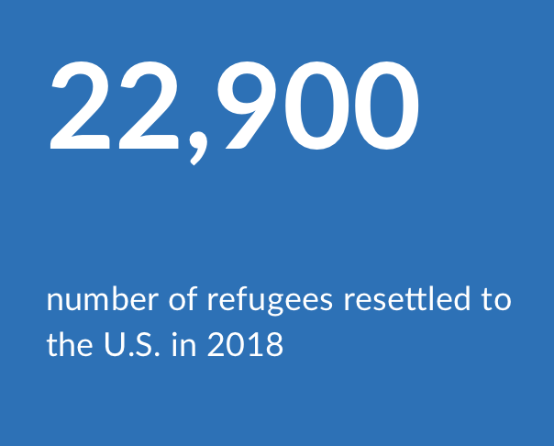
Refugees in the United States
One of the largest resettlement programs in the world since the 1970s
Lengthy and thorough process that can take upwards of two years
8 Federal agencies are involved in the screening process

Slide 5
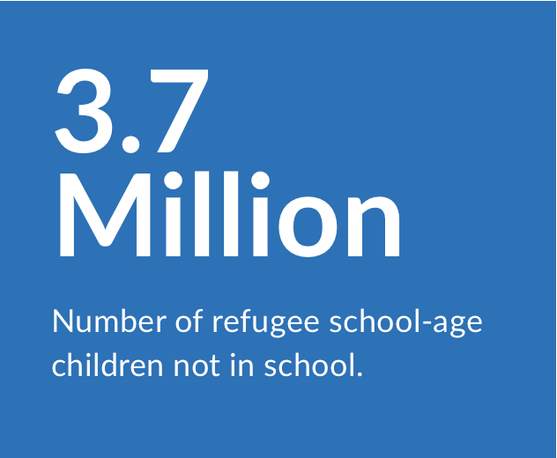
Disparities in Education
Refugees children are five times more likely to be out of school
76 percent of refugee adolescents were not in secondary school.
4% of refugee adolescents, and 9% of refugee adolescents in low-income countries→ attend secondary school
  Globally, 84% of adolescents attend secondary school
Only 3% of refugees enroll in college or university
Gender Gap:
  For every 10 refugee boys that attend primary school, fewer than 8 refugee girls attend
    Fewer than 7 attend secondary school

Slide 6
Health Disparities
Lack of Universal Health Coverage can lead to excessive costs for refugees and migrants, many of whom pay out of pocket for health services
Due to stressful situations, refugees are forced to live through mental health problems
Language and cultural barriers often lower the quality of health care provide to migrants and refugees

Slide 7
World Health Organization Goals
Improve health policies for migrants and integrate them to host societies
Develop health systems that are sensitive to needs of migrants
  Provide services that are in the right language
  Pay attention to unique health problems (reproductive health, mental health, trauma..)
Monitor and collect data on the health needs of migrants

Slide 8
Current Policies and Issues
Fee for naturalization has increased more than 650% in the last 20 years→ attacks eligible, low income immigrants→ Delays and fees are leading to the disenfranchisement of this community
New policies are unfairly targeting applicants with physical or developmental disabilities or mental impairments→ leading to denials in application or burden of reapplication
Department of Homeland Security has cut its refugee corps by almost half→ Fewer DHS staff are able to conduct required in-person interviews
January 15, 2020→ Federal judge halted current administration policy allowing enabling local state governments to block refugees

Slide 9
Steps to Action
Call Representatives and voice concerns and support regarding refugee crisis
  Ask senators to support refugee in the resettlement process
Donate to refugee-support organizations: International Rescue Committee, UNHCR
Volunteer in refugee camps and communities
  https://www.rescue.org/volunteer
If business owner, hire refugees
  https://www.rescue.org/page/7-reasons-why-refugees-make-great-employees
House refugees
  https://www.airbnb.com/openhomes

Slide 10
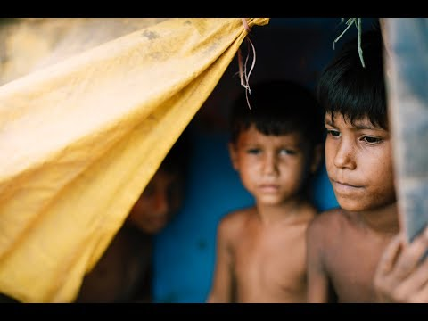

Slide 11
“Refugees are mothers, fathers, sisters, brothers, children, with the same hopes and ambitions as us—except that a twist of fate has bound their lives to a global refugee crisis on an unprecedented scale.”
— Khaled Hosseini

Slide 12
References
https://www.unrefugees.org/refugee-facts/statistics/
https://www.unrefugees.org/what-we-do/education/
https://www.who.int/migrants/news-events/en/#unga72
https://www.acf.hhs.gov/orr/programs/refugee-health
https://www.rescue.org/sites/default/files/document/4214/2019-10citizenshipreport.pdf

