Slide 1
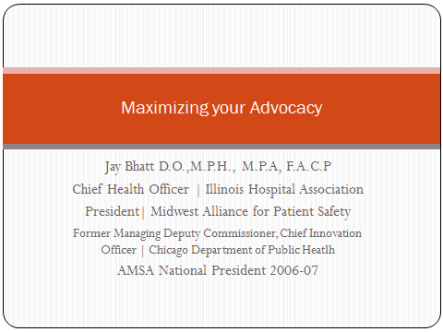

Slide 2
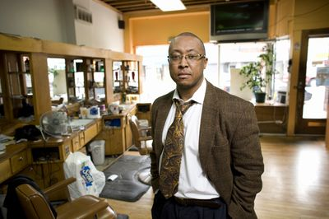
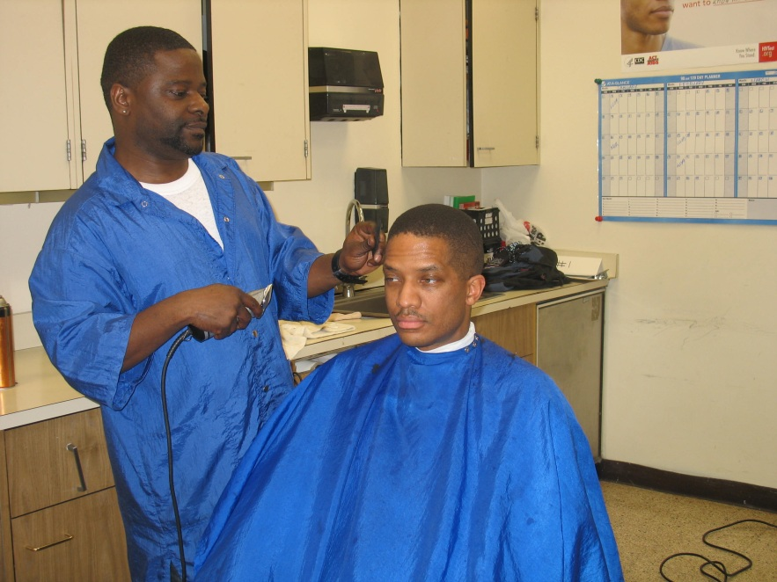

Slide 3


Slide 4


Slide 5

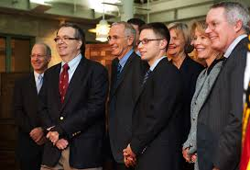

Slide 6
Public Narrative
Notes:
f an organization veers in a completely new direction — for example, if it assumes all of a patient’s risk — the CFO’s responsibilities will need to follow. “At a certain point, if you’re taking on 100 percent risk, you’re an insurance company, and your hospitals are cost centers,” Sussman says. “That is a significant change for capital planning and financial planning.”
Under a population health model, there’s also a need for greater outreach and collaboration with payers, community organizations, and advocacy groups, and the population health executive can spearhead these important partnerships,” he added.

Slide 7

What is Public Narrative
What am I called to do
What my community is called to do
What we are called to do now…
Who is calling me
Why these people
And why here now in this place
STORY OF SELF, STORY OF US, STORY OF NOW
LEADERSHIP ART

Slide 8
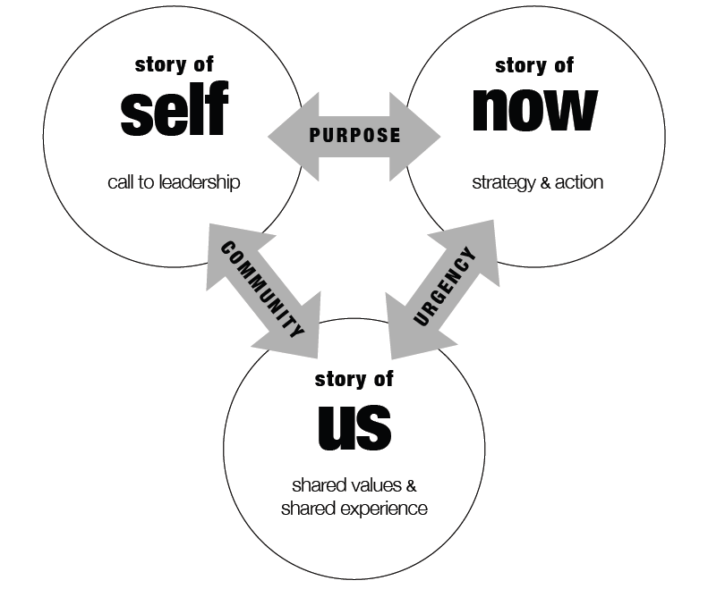
Public Narrative Interwoven

Slide 9
VALUES and EMOTIONS
Many of us experience our values through our emotions
Martha Nussbaum: because we experience value through emotion, trying to make moral choices without emotion inormation is futile
Engaging HEART, HEAD, and HANDS
Leadership requires engaging others in purposeful action by mobilizing feelings that can facilitate it to challenge feelings to inhibit it

Slide 10

Mobilizing Action
Action Barriers
Inertia
Fear
Apathy
Self Doubt
Isolation
Action Catalysts
Urgency
Hope
Anger
YCMAD
Solidarity

Slide 11
PLEDGES
Notes:
f an organization veers in a completely new direction — for example, if it assumes all of a patient’s risk — the CFO’s responsibilities will need to follow. “At a certain point, if you’re taking on 100 percent risk, you’re an insurance company, and your hospitals are cost centers,” Sussman says. “That is a significant change for capital planning and financial planning.”
Under a population health model, there’s also a need for greater outreach and collaboration with payers, community organizations, and advocacy groups, and the population health executive can spearhead these important partnerships,” he added.

Slide 12


Slide 13
PROPS
Notes:
f an organization veers in a completely new direction — for example, if it assumes all of a patient’s risk — the CFO’s responsibilities will need to follow. “At a certain point, if you’re taking on 100 percent risk, you’re an insurance company, and your hospitals are cost centers,” Sussman says. “That is a significant change for capital planning and financial planning.”
Under a population health model, there’s also a need for greater outreach and collaboration with payers, community organizations, and advocacy groups, and the population health executive can spearhead these important partnerships,” he added.

Slide 14
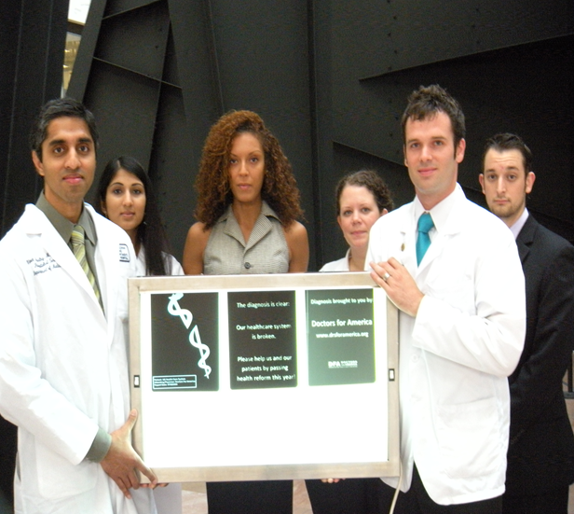

Slide 15


Slide 16
BIRDDOGGING
Notes:
f an organization veers in a completely new direction — for example, if it assumes all of a patient’s risk — the CFO’s responsibilities will need to follow. “At a certain point, if you’re taking on 100 percent risk, you’re an insurance company, and your hospitals are cost centers,” Sussman says. “That is a significant change for capital planning and financial planning.”
Under a population health model, there’s also a need for greater outreach and collaboration with payers, community organizations, and advocacy groups, and the population health executive can spearhead these important partnerships,” he added.

Slide 17
https://www.youtube.com/watch?v=OvMf8ku8HGM
https://www.youtube.com/watch?v=-P7ocikuDKI
KASICH
https://www.youtube.com/watch?v=FAId4MiRagM

Slide 18
STRATEGY and CAMPAIGNS
Notes:
f an organization veers in a completely new direction — for example, if it assumes all of a patient’s risk — the CFO’s responsibilities will need to follow. “At a certain point, if you’re taking on 100 percent risk, you’re an insurance company, and your hospitals are cost centers,” Sussman says. “That is a significant change for capital planning and financial planning.”
Under a population health model, there’s also a need for greater outreach and collaboration with payers, community organizations, and advocacy groups, and the population health executive can spearhead these important partnerships,” he added.

Slide 19
What started all of this?
A completely hypothetical story . . .
Question the objectivity of our medical education
New policy: lecturer disclosure
  Known negative effects: the perverse effects of disclosure
  Possible effects: awareness (?)
What about a comprehensive COI policy?

Slide 20
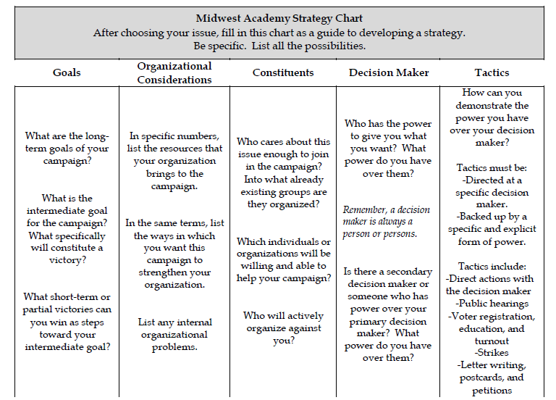
The Strategy

Slide 21
How then can we proactively organize our resources to shift the power enough to win the change we
want—and have more capacity to win more over time
Since power is a kind of relationship tracking
1) What!do!WE!want?!
2) Who!has!the!RESOURCES!to!create!that!change?
3) What!do!THEY!want?
4)What!resources!do!WE!have!that!THEY!want!or!need?

Slide 22
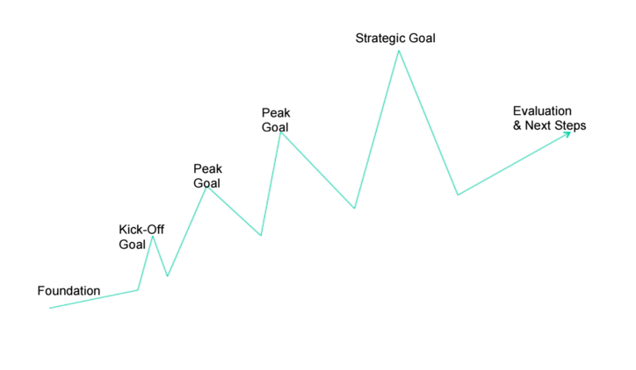

Slide 23

@bhangrajay

