Slide 1
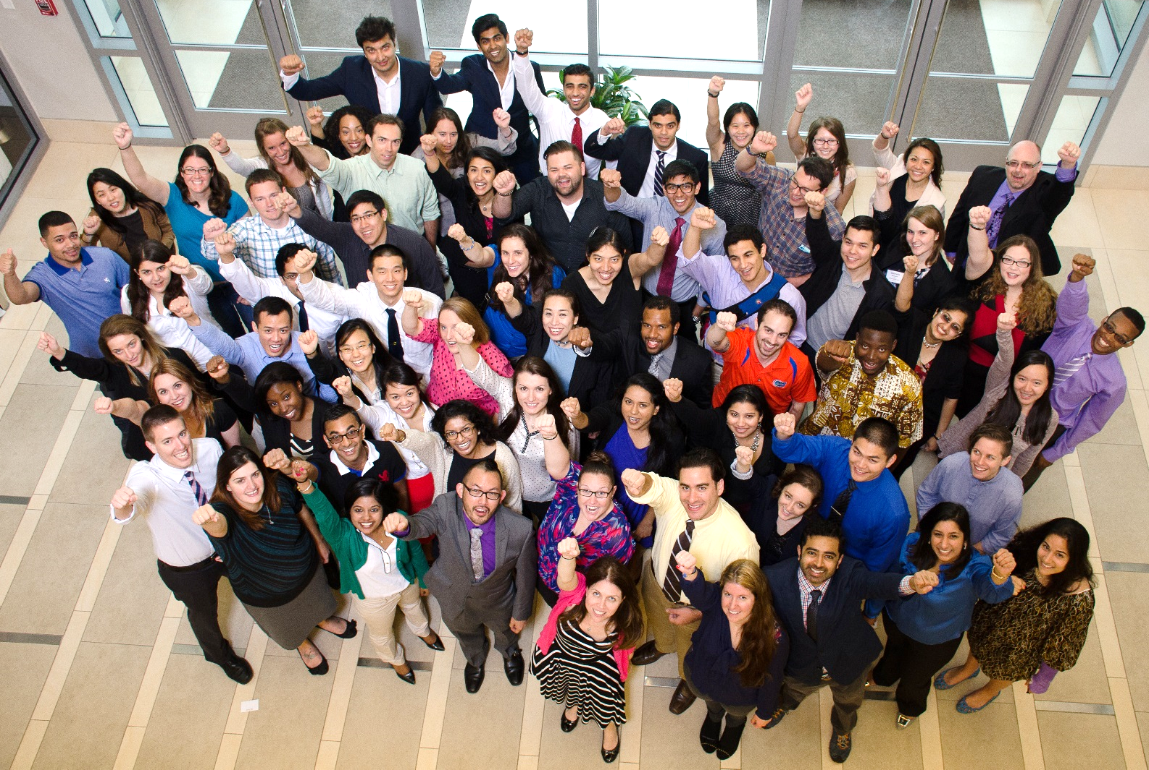
CORE LEADERSHIP FORUM
www.amsa.org
YOUR VOICE. YOUR GOALS. YOUR VISION. YOUR PASSION

Slide 2
Welcome To CORE-LF!
Deb V. Hall, M.D. – National President

Slide 3
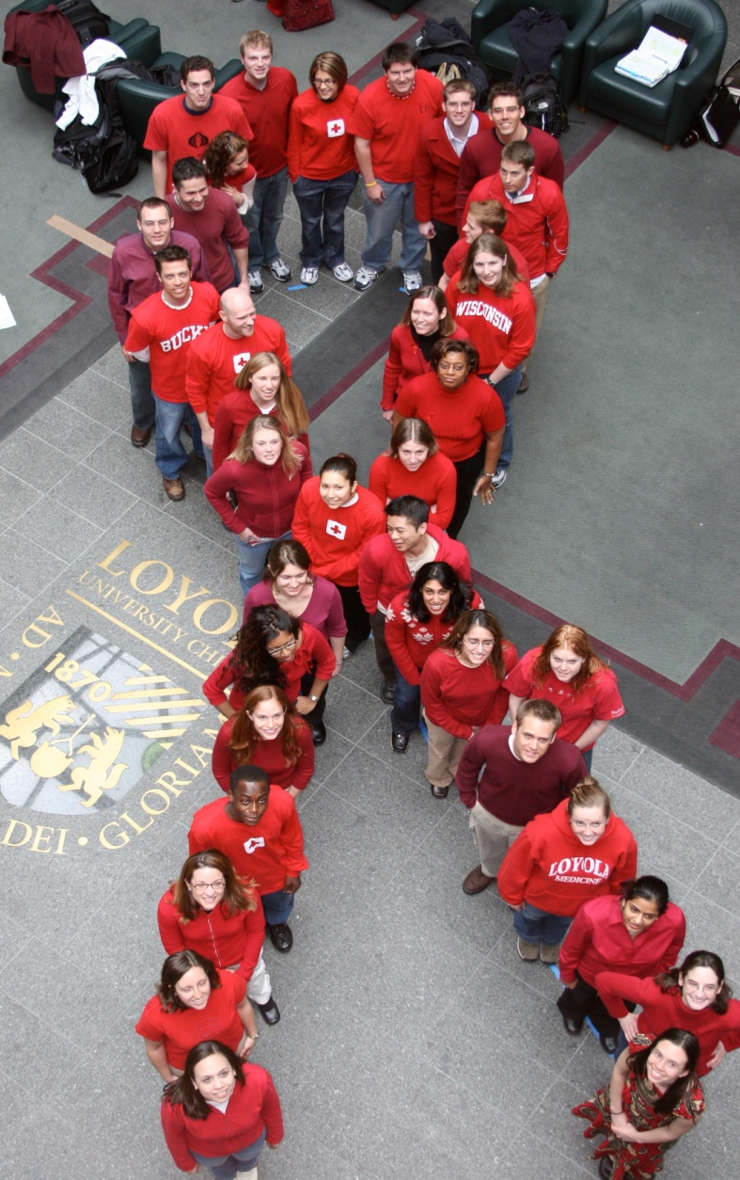
Today’s Session
Wednesday, July 8 7pm – 9pm Eastern
Welcome & Overview of Goals
Understanding the House of Delegates
Membership Basics
Member Benefits
Member Recruitment
National Action Committees & Campaigns
National Events & Education

Slide 4
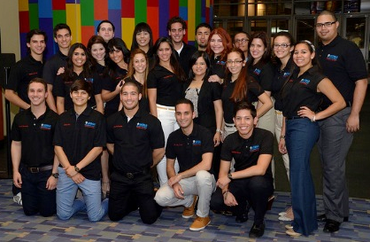
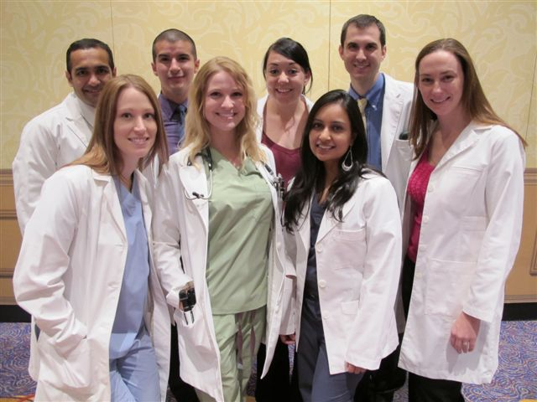
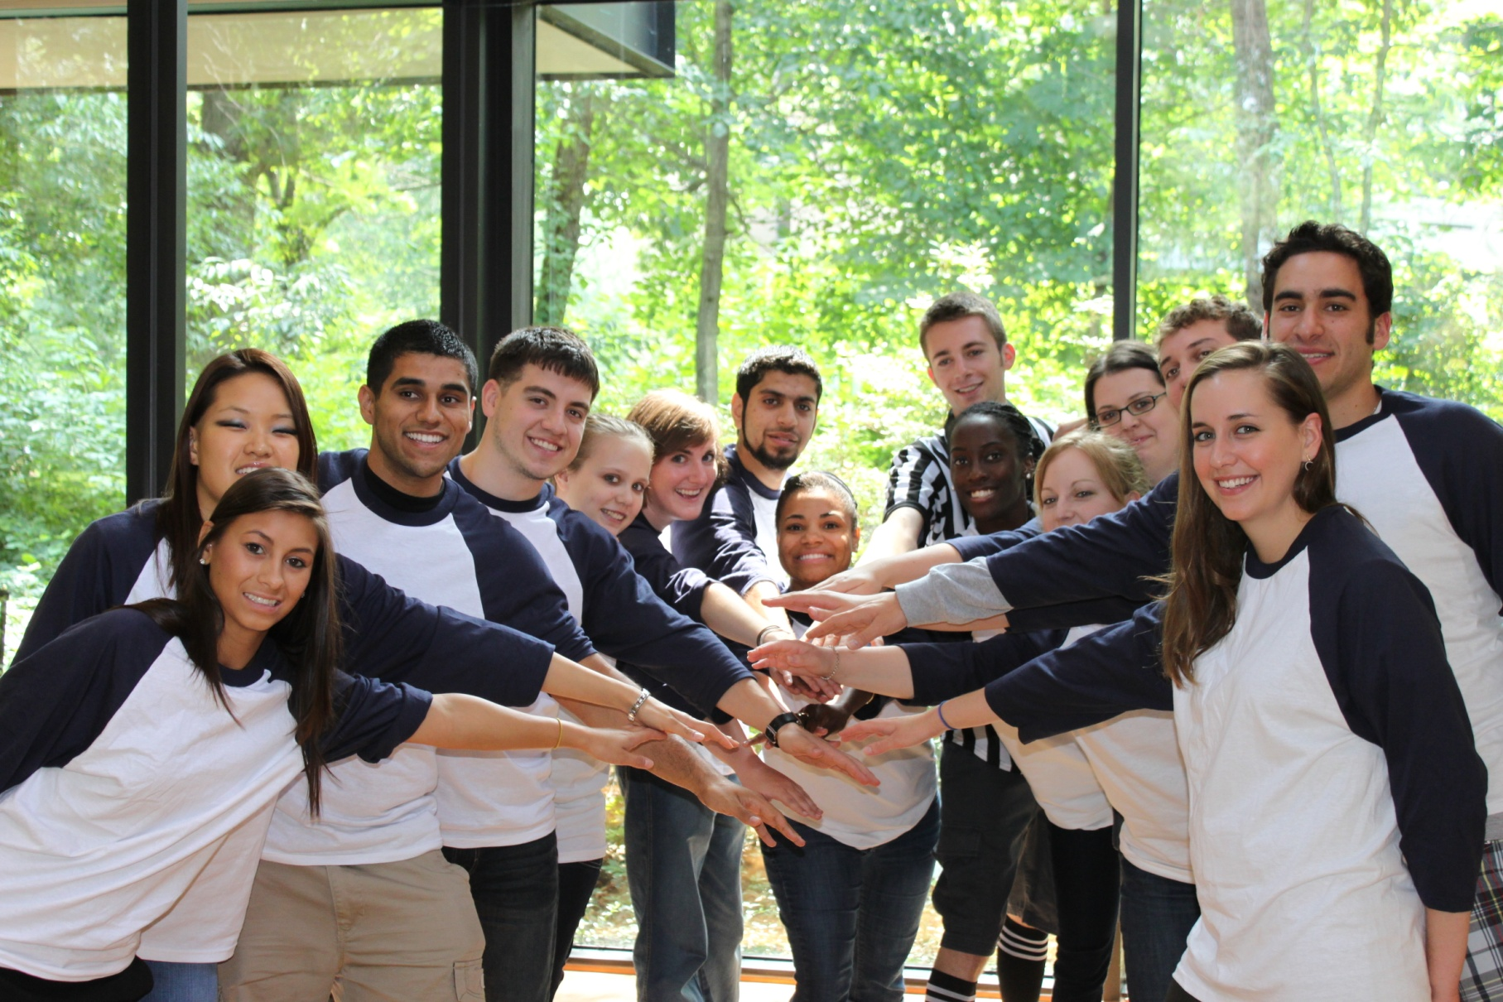
Have Questions?
Please use the chat box to submit questions to the full group or to specific individuals.
We encourage you to ask the full group!
National Leaders, Regional Directors and Staff are all online to help answer questions throughout the session.
We’re all here to learn, so don’t be shy!

Slide 5
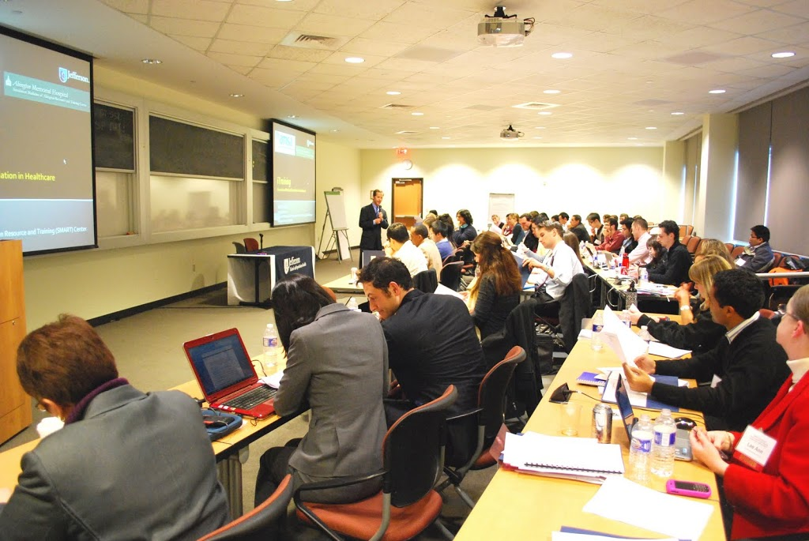
Up First …
AMSA House of Delegates

Slide 6
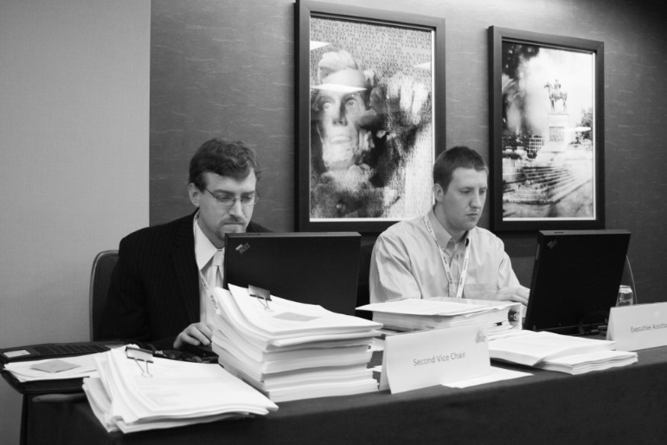
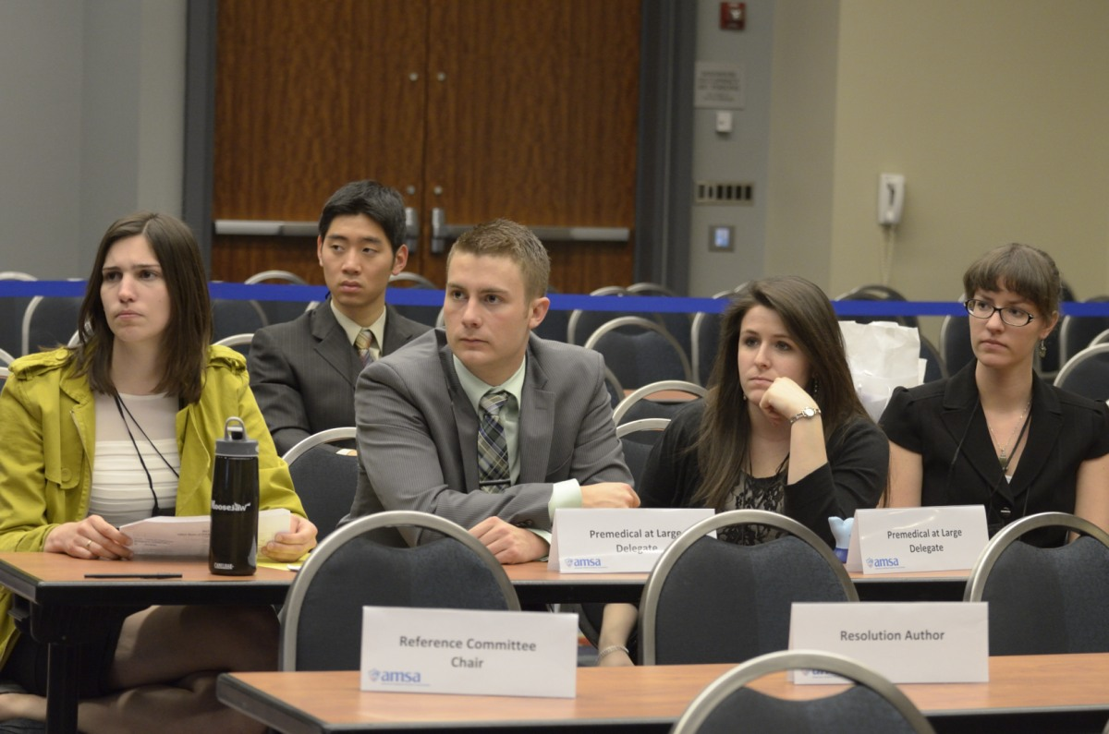
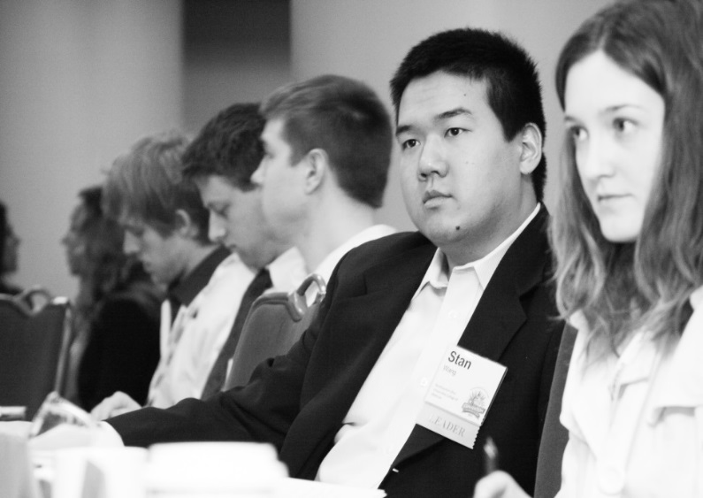
House of Delegates
Members Make AMSA Policy

Slide 7
House of Delegates
https://youtu.be/_5VY2mh-kEI

Slide 8
Up Next …
Membership Basics Michael Sparks – International Trustee

Slide 9
Membership Snapshot
44,064 Total Members as of June 15, 2015

Slide 10
Membership Dues
Premedical Students - $75
Domestic Medical Students - $75
International Medical Students - $75
Graduate Students - $10
Physician - $10 annually
Supporting Students - $50 annually

Slide 11
Domestic Medical Dues
Reinstated domestic medical dues as of May 1.
Students that joined prior to May 1 DO NOT pay.
There are two primary reasons for the change:
Increase member engagement.
Provide rebates to support chapter activities.
This is a BIG change and will be a hot topic this Fall.

Slide 12
What’s the Answer?
“$75 is a lot of money for a student. What do I get for my $75?”
One-time fee for each phase of education.
Tangibles: Welcome gift, discounts, The New Physician, Action Committees, etc.
Intangibles: Leadership, advocacy, public service, institutional change, etc.

Slide 13
What’s the Answer?
“Can I become just a local member and not a national member?”
No. Students must be a national AMSA member in order to participate in chapter activities.
LOCAL ONLY
NO EXCEPTIONS!!!

Slide 14
Chapters
628 chartered chapters.
Approximately 230 active chapters.
Active chapters must be chartered + have five members + have officers on file.
Definition of “active” will evolve.
New chapters are chartered each year at convention.

Slide 15
Chapter Rebates
Active chapters receive $15 for each new member.
Payments made August and January.
August = members from January – July.
January = members from August – December.
Payments will be made via check, direct deposit or stored as credit in chapter record.
Rebate expires if chapter is not active.

Slide 16
What’s the Answer?
“How do I update our chapter officers?”
Visit the AMSA website and complete the Chapter Officer Submission form.
www.amsa.org/chapters/submit-officers/
It’s SUPER important to have chapter officers on file.
No officers = no rebate, no national updates, etc.
!!!

Slide 17
What’s the Answer?
“How do I know who is a member of my chapter?”
Chapter Presidents can generate a chapter roster via the AMSA website.
Chapter Officers can complete an online form and request a chapter roster.
http://www.amsa.org/chapters/officer-resources/request-chapter-roster/

Slide 18
Recruitment Tools
Recruitment Materials
Brochure, fliers, videos, etc.
Download online and print as needed.
Chapter Rebate Program
Earn $15 for every new member.
Payments scheduled for August & January.
Only active chapters eligible.
Fall Frenzy Campaign
Runs August 1 – December 31.
Earn one free convention registration for reaching recruitment goal.

Slide 19
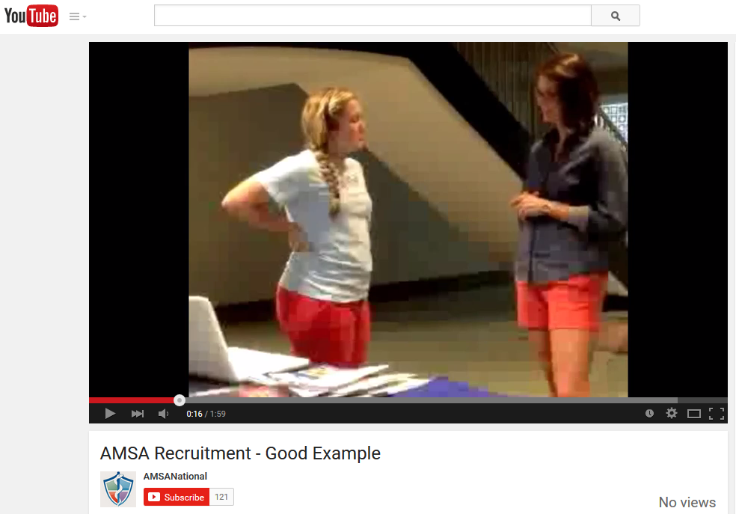
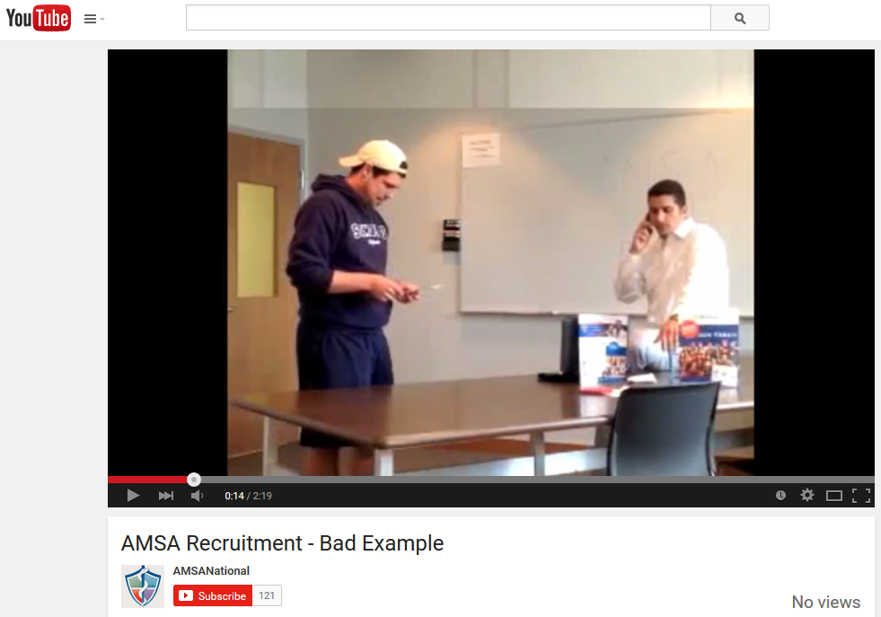
Member Recruitment
Good Example
https://youtu.be/o3tZYePpluE
Bad Example
https://youtu.be/DxfdcxapIGM

Slide 20
Educational/Clinical Benefits
AMSA has 20+ partners that help members save! www.amsa.org/benefits

Slide 21
Premedical Members
Each new premedical member receives MCAT in a Box or similar.
Stackable 10% course discount on select MCAT programs or $500 discount on MCAT Summer Intensive Program.
Free Foundations of Biochemistry web course.
Provides chapters with course scholarships (based on chapter size) that can be raffled.
Provides 50% course discount for executive board members for chapters that have at least 51 members (limit 4 per chapter).

Slide 22
Premedical Members
Provides 10% discount on all medical school admissions consulting services.
Offers 5 scholarships of $1,000 each that will be applied toward AP summer hospital internship programs (4 weeks or more).
Awards 3 scholarships that covers registration fee and price of a two-week physician-shadowing program in Tanzania or Thailand.

Slide 23
Medical Members
Discounted access to USMLE eCoach services, question bank, online integrated cases, and in-person retreats.
Chapters can host instrument sale for fundraising. Also, the online store prepared for AMSA members and avoid bookstore prices.
Free incentivized learning platform that allows you to earn as you learn.
Receive special AMSA rate on Practical Reviews, a point of care reference tool.

Slide 24
Medical Members
Provides 10% off standard policy pricing for affordable, short-term malpractice insurance coverage options to med students.
Med students qualify for low rate refinancing when match to a residency program. Pay $100/month through residency & fellowship.
Free Realtor Match helps you find a realtor who specializes in working with doctors. Also receive 3 free months of home appliance warranty.

Slide 25
All Members
Receive 30% discount (code WFF004AF) and free shipping. Join the LEARN program and get free access to a variety of study tools.
Receive 40% off and free shipping.
Receive two months of free Firecracker USMLE or MCAT prep access. Members receive the best discount year-round.
Receive discounts on courses and the certification exam for bilingual health care providers.

Slide 26
All Members
Provides three $1,000 scholarships for placements in Argentina, Bolivia, Ecuador, India, Mexico, South Africa, and Uganda.
Earn cash back on purchases with the BankAmericard Cash Rewards Visa Signature credit card. Receive an AMSA branded debit card.
Receive discounts on car, renter, condominium, and homeowner insurance. No obligation quotes support AMSA programming.
Receive access to affordable and comprehensive health insurance.

Slide 27
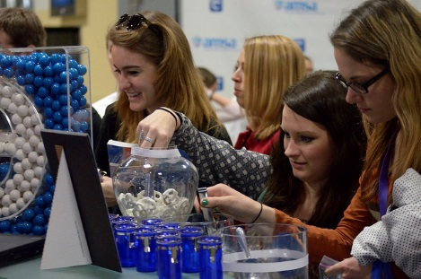
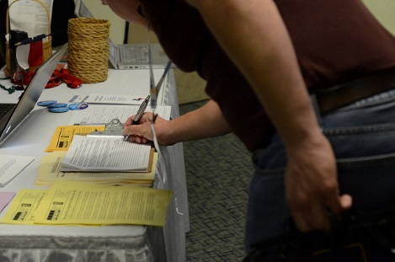
Member Benefits
AMSA adds new benefits throughout the year.
Be sure to visit www.amsa.org/benefits to see the full array of benefits available to you and your members!

Slide 28
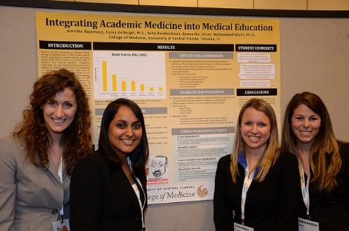
Up Next …
AMSA Programming
Perry Tsai – VP for Program Development
Stefanie Howard – Premedical Trustee

Slide 29
Think of AMSA as your training ground ... because it takes more than medical school to make a physician.

Slide 30
The MORE in AMSA …
Medical school covers
preclinical knowledge and clinical skills.
AMSA covers
preclinical knowledge and clinical skills
AND
diversity, justice, meaning, culture, sexuality, wellness, professionalism, conflict-of-interest, advocacy, reform, global health, leadership, inequity, community, student debt, etc.

Slide 31
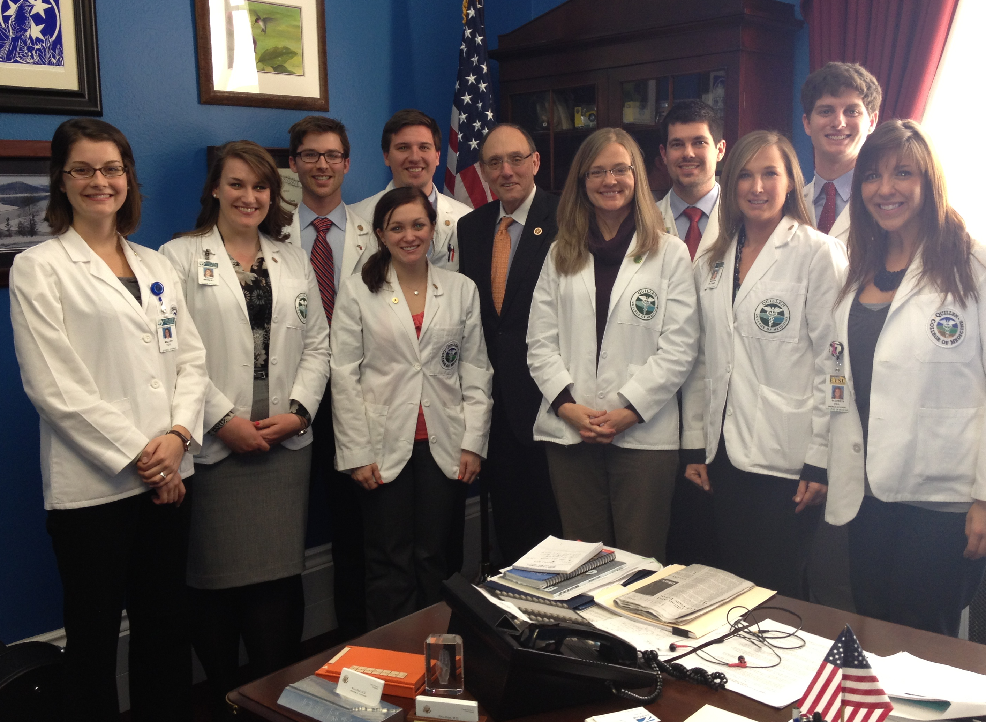
To Make You Not JUST a Physician …
AMSA prepares you for your future as a …
physician-advocate
physician-humanist
physician-educator
physician-researcher
physician-traveler…
physician-leader.

Slide 32
AMSA brings together
Education and Advocacy
To transform you into a physician-leader.

Slide 33
AMSA Programming Gives You …
Content
Opportunities
Experiences
through
AMSA publications, AMSA ACT/campaigns, AMSA Academy, AMSA partners, and AMSA events.

Slide 34
AMSA Publications
The New Physician magazine
AMSA Ad Lib podcast
Weekly Consult digest
AMSA On Call blog

Slide 35
Action Committees & Teams (ACT)
Community & Public Health Action Committee
Gender & Sexuality Action Committee
Global Health Action Committee
Grassroots Organizing Team
Health Policy Team
Medical Education Team
Premedical Leadership Team
Race, Ethnicity & Culture in Health Action Committee
Trainee Wellness & Professionalism Action Committee

Slide 36
Advocacy Campaigns
Just Medicine Campaign
Health Care for All Campaign
AIDS Advocacy Network

Slide 37
ACT & Campaigns
Develop content for members.
Organize events for education, discussion.
Create opportunities for advocacy, networking.
Foster members as potential leaders.
Partner with related organizations.
Support relevant local/national efforts.
Engage with members through social media.

Slide 38
Previous Weeks of Action
Just Medicine Week (September)
National Primary Care Week (October)
Health Equity Week of Action (January)

Slide 39
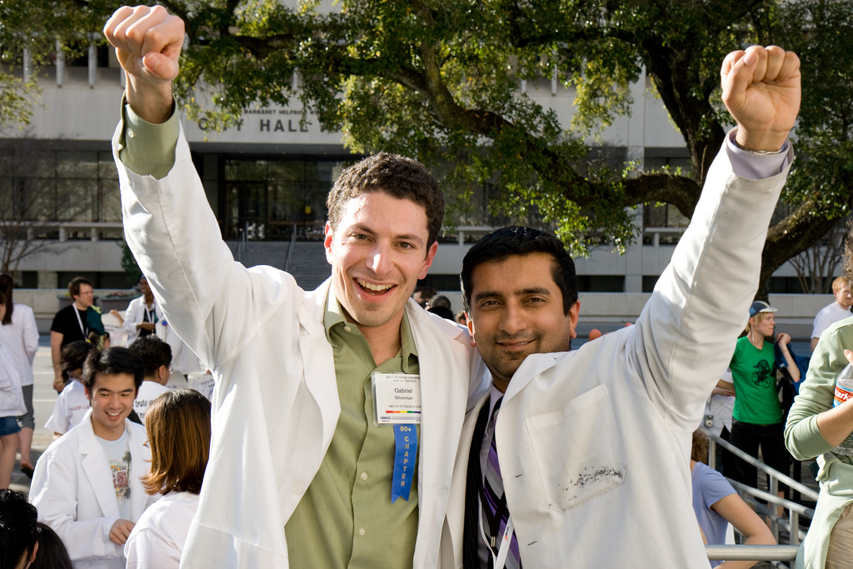
AMSA Academy

Slide 40
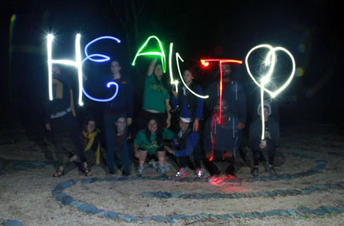
AMSA Academy
In-Person Experiences
Primary Care Interprofessional Leadership Institute (Sept 19-20, 2015. Deadline Aug 30)
Humanistic Elective in Activism, Reflective Transformation, and Integrative Medicine (HEART-IM) (Mar 22-Apr 22, 2016. Rolling deadline)
Leadership and Education Program for Students in Integrative Medicine (LEAPS into IM) (2016 dates TBA)

Slide 41
AMSA Academy
Scholars Programs
5-6 month online courses with structured curriculum, lectures from experts, discussions with other scholars, opportunities for project development or advocacy work
Open enrollment, registration deadline Sept 14, 2015
Cultural Sensitivity SP
Global Health SP
Health Equity SP
Integrative Medicine SP
Medical Humanities SP
Patient Safety SP
Public Health SP
Premedical SP
Health Care for All SP
AIDS Advocacy Network SP
Just Medicine SP
Sexual Health Leadership Course by application
Advocacy Leadership Course by application
Application deadline for Leadership Courses is Sept 1

Slide 42
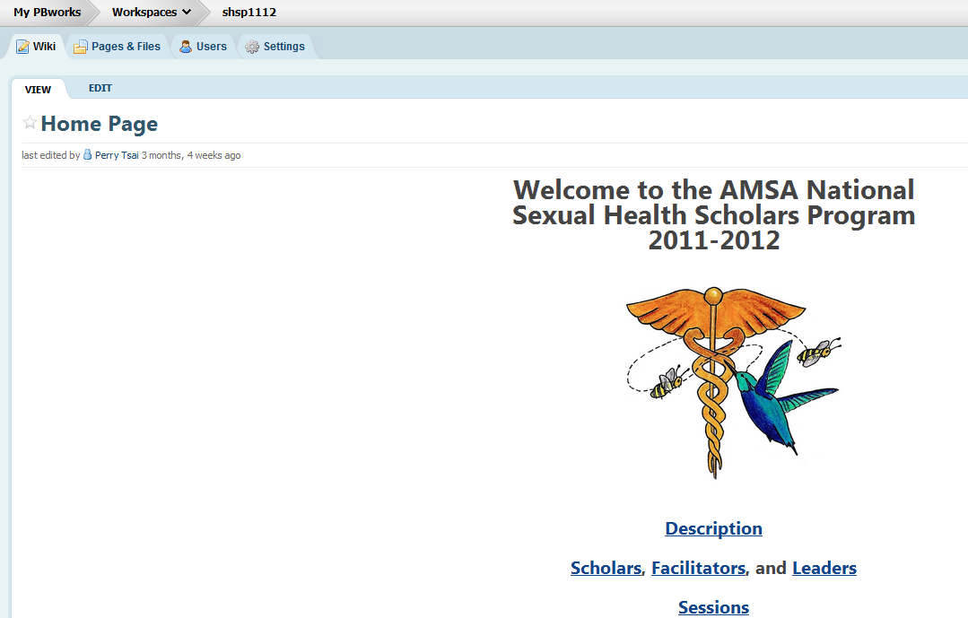
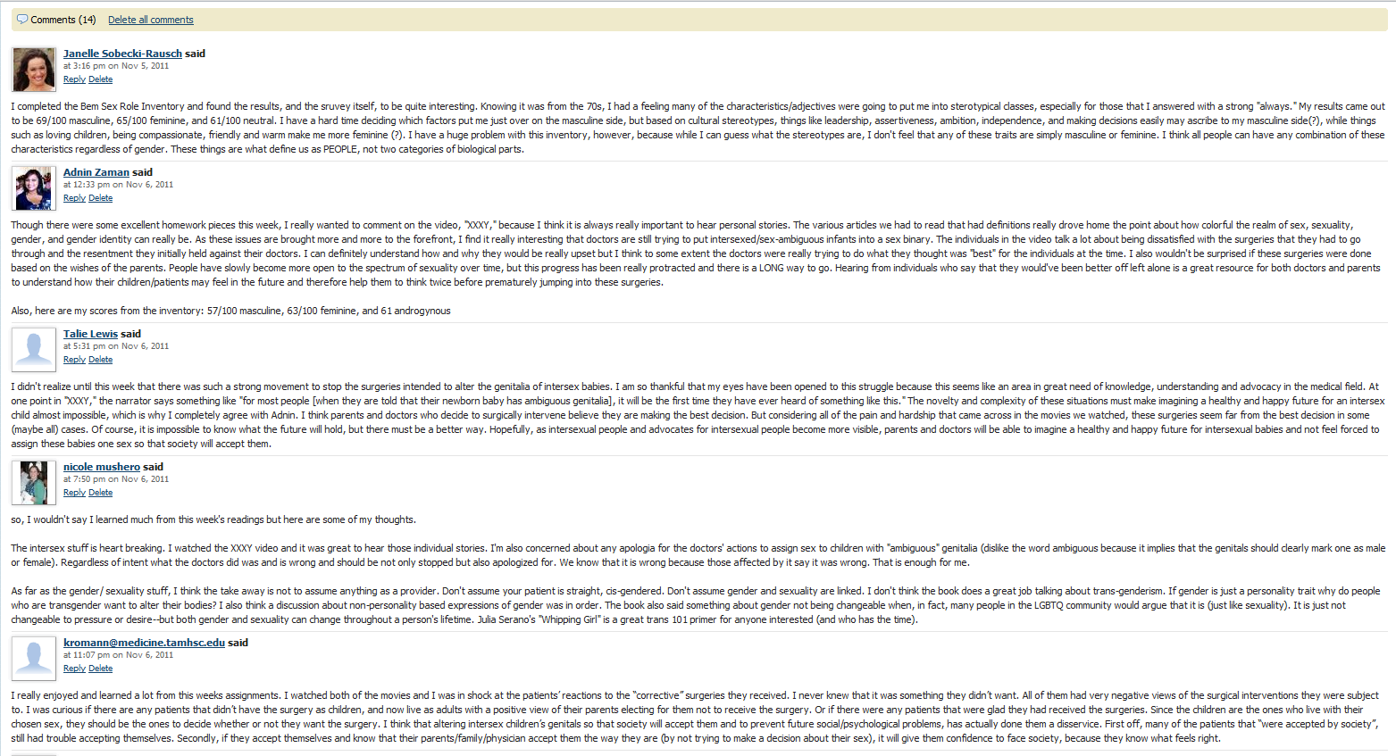
Scholars Program

Slide 43
International Opportunities
Child Family Health International global health rotations.
Atlantis Project global health internships.
Gap Medics physician shadowing program for premeds.
International Federation of Medical Students’ Associations clinical exchanges.

Slide 44
More Programming Partners
National Physicians Alliance: Healthcare reform and health policy, gun violence prevention, reproductive rights, professionalism, and conflicts of interest in medical education
Wolters Kluwer Health/Lippincott: Medical education, learning resources, clinical skills, Lippincott Editorial AMSA Reviewer Network (LEARN) Program
RESULTS: Global health, advocacy on poverty and poverty-related diseases
Kaplan Test Prep: Basic sciences, MCAT critical thinking, learning resources, med school admissions seminars, personal statement and interview workshops
Canopy: Medical Spanish, culturally and linguistically appropriate healthcare services training

Slide 45
AMSA Programming
AMSA programming gives you content, opportunities, and experiences through our publications, ACT/campaigns, Academy, partners, and events.
At nearly every level, our members are involved directly as advocates, educators, and leaders.
Each and every member is invited to engage, participate, contribute as they can, in order to make real change, make personal meaning, and make new friends.

Slide 46
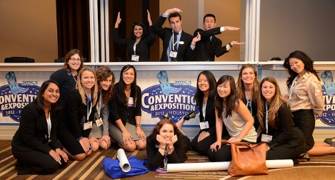
Up Next …
AMSA Events & Education Jeff Koetje, M.D. – Director of Experiences

Slide 47
Fall Conferences
New York, NY Saturday, November 14
Columbia University College of Physician & Surgeons
Humanity at the Heart of Health Care
Chicago, IL Saturday, November 21
University of Illinois College of Medicine at Chicago
Communication at the Center of Care
REGISTER TODAY: www.AMSAFallConference.org

Slide 48
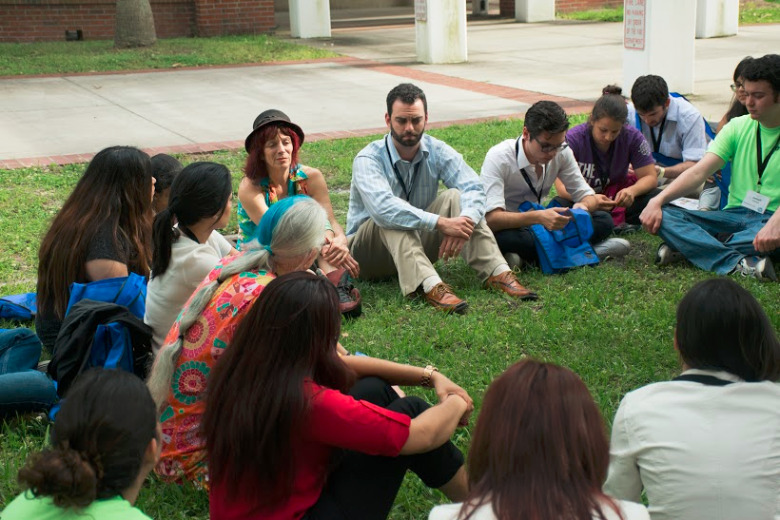
PremedFest
Location TBA
Target Date: Saturday, February 13, 2016
www.AMSAPremedFest.org

Slide 49
Annual Convention
Your Pathway to Clinical Exploration
Hyatt Regency Crystal City, Washington, D.C.
Thursday, March 31 – Sunday, April 3, 2016
REGISTER TODAY: www.AMSAConvention.org

Slide 50
Annual Convention
Thursday: Advocacy & Rally Day, opening keynote, and networking event
Friday: Keynote, breakout sessions, premed and med student team challenges, poster/project session, exhibit hall
Saturday: Keynote, breakout sessions, Interview Like a Ninja, clinical skills, exhibit hall, Pre-Health Fair, Residency Round Tables, ACT/Campaign socials
PLUS: Tours of DC-area attractions!
REGISTER TODAY: www.AMSAConvention.org

Slide 51
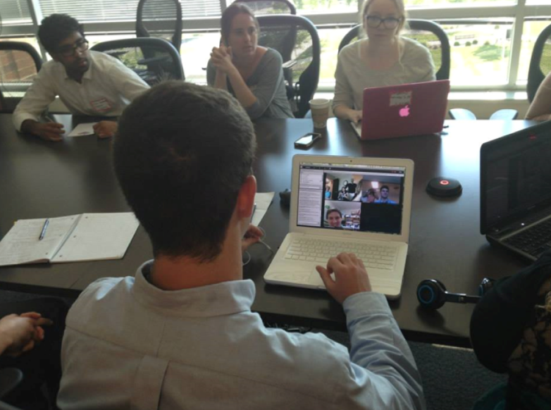
Scholars Program (online)
Cultural Sensitivity
Patient Safety
Medical Humanities
Integrative Medicine
Public Health
Global Health
Health Equity
Premedical
Health Care For All
AIDS Advocacy
Just Medicine
REGISTER TODAY: www.amsa.org/scholars-programs

Slide 52
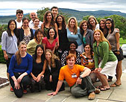
Institutes (in-person)
Primary Care Interprofessional Leadership Institute, in partnership with NEI-AHEC
September 19-20 at Ball State University, Muncie, IN
Go to www.amsa.org/PCILI for more information and to register
SeaCouver Institute
October 2015
Spend time in Seattle and Vancouver learning about US and Canadian healthcare systems (info coming soon)
Patient Safety Leadership Institute, in partnership with Academic Group
October 2015 at location TBD (info coming soon)

Slide 53
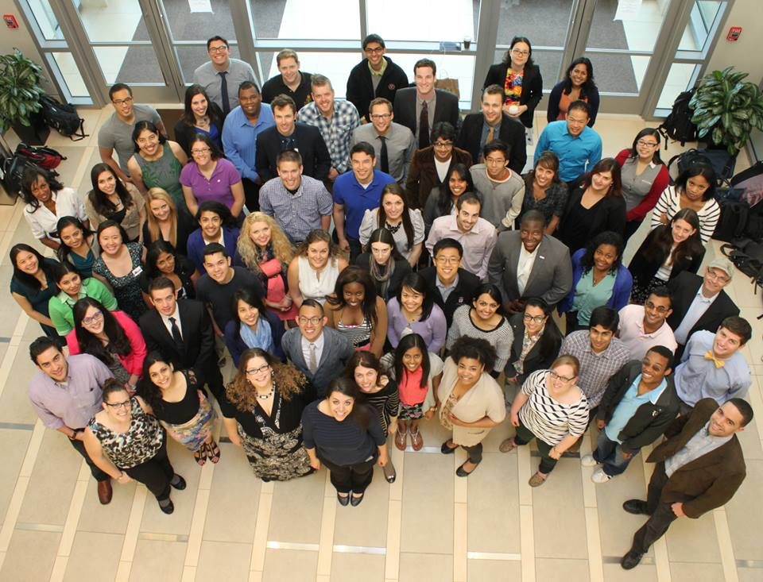
Final Thoughts
Jeff Koetje, M.D. – Director of Experiences

Slide 54
Closing Remarks
Noreen Rich – Chief Membership Officer

Slide 55
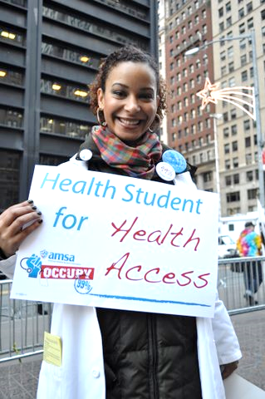
Thank you!
We will stay online a little longer to answer any last minute questions via the chat box.
Otherwise, prepare for a fun year!

