Slide 1
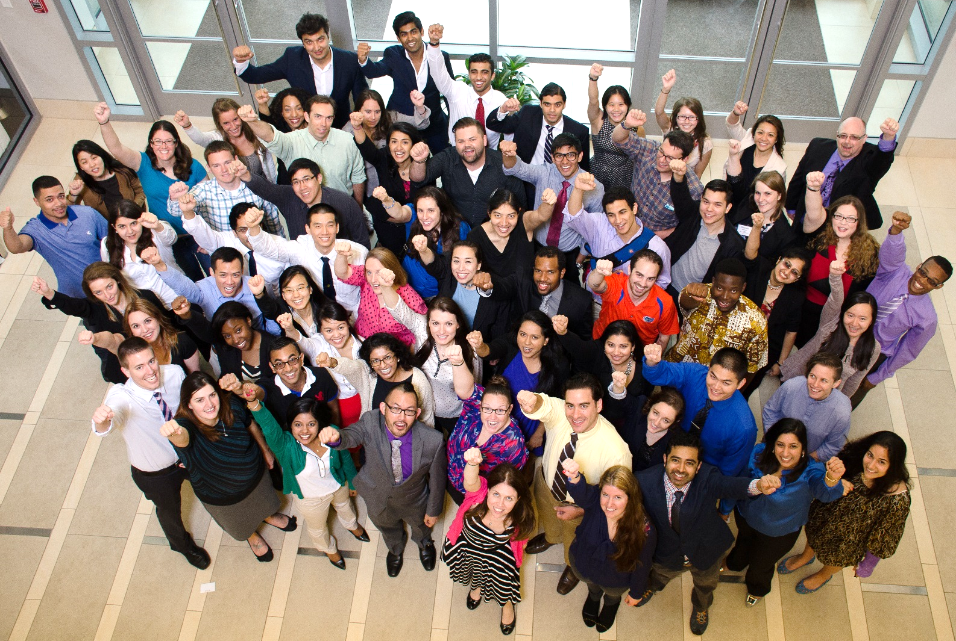
CORE LEADERSHIP FORUM
www.amsa.org
YOUR VOICE. YOUR GOALS. YOUR VISION. YOUR PASSION

Slide 2
Welcome to CORE-LF!
If you can’t tell, we’re excited to be here!

Slide 3
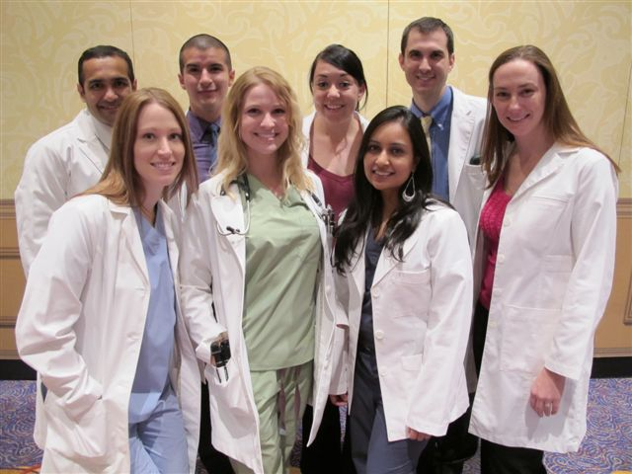
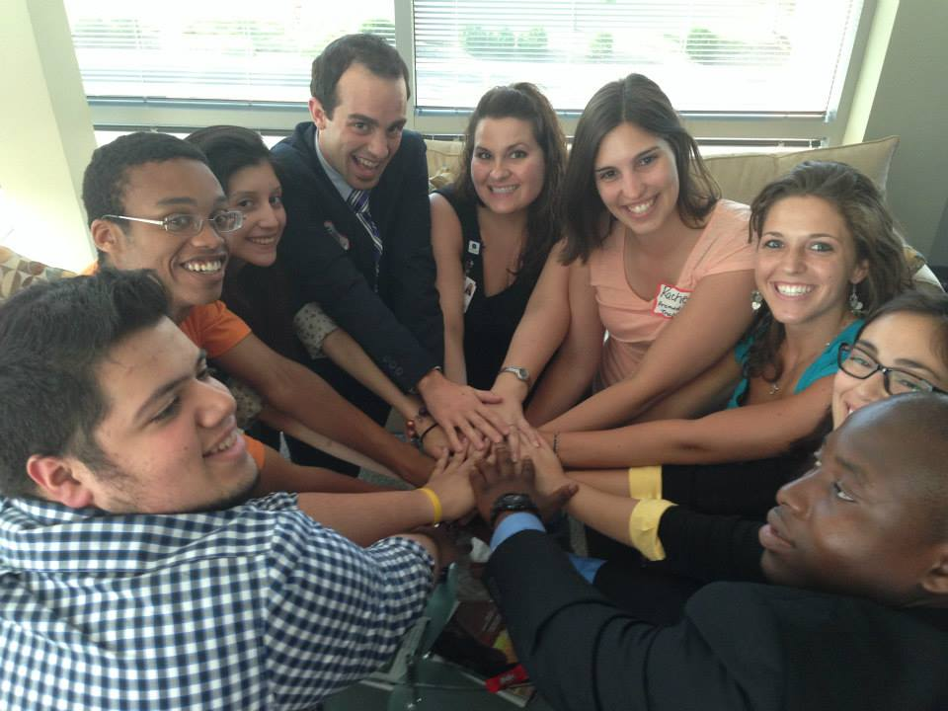
Today’s Session
Tuesday, July 7 7pm – 9pm Eastern
Welcome & Overview of Goals
AMSA History & AMSA Today
AMSA Narrative
You Are the Face of AMSA
Chapter Success Stories
Being a Chapter Officer
Running Effective Meetings
Fundraising Tips

Slide 4
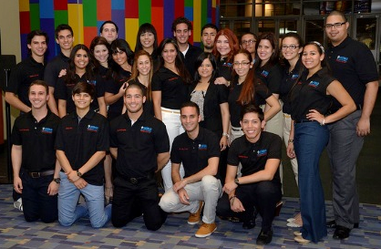
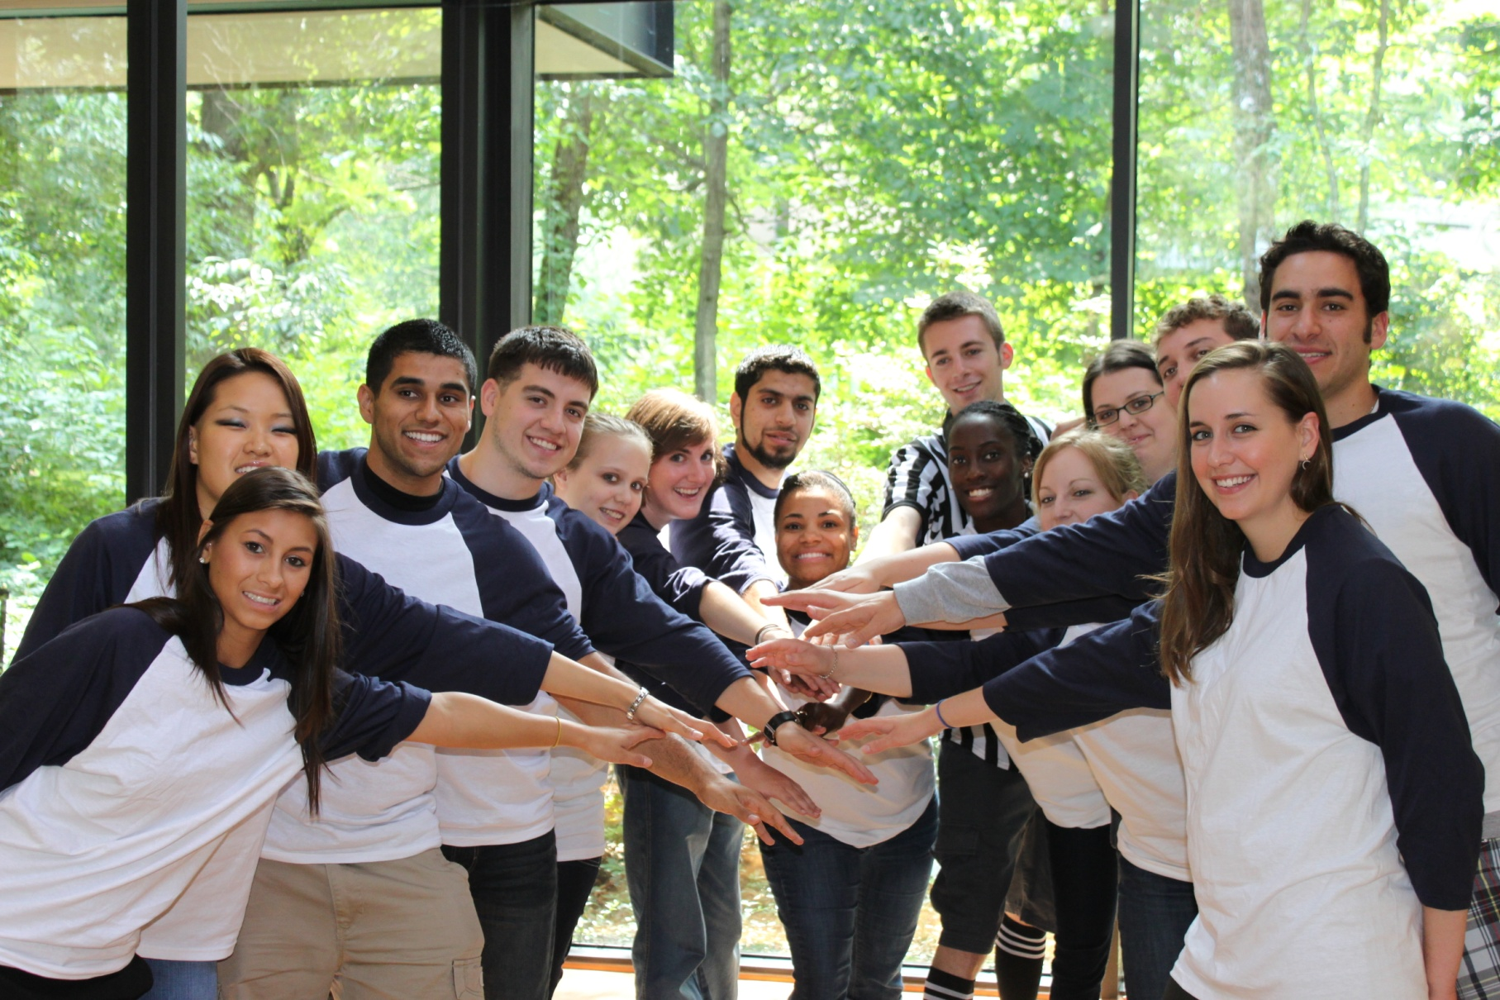
Have Questions?
Please use the chat box to submit questions to the full group or to specific individuals.
We encourage you to ask the full group!
National Leaders, Regional Directors and Staff are all online to help answer questions throughout the session.
We’re all here to learn, so don’t be shy!

Slide 5
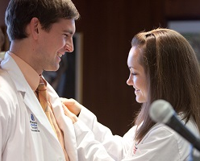
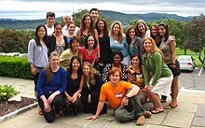
Goals & Expectations
Goal of CORE LF is to …
Come together as a community.
Share stories, suggestions, and advice.
Identify resources available to you.
Describe national campaigns and opportunities.
Provide starting point for your year.
Support one another!

Slide 6
Goals & Expectations
Chapter officer expectations …
Be the face of AMSA.
Recruit and engage with local members.
Focus on activities important to you and your chapter.
Ensure the short & long term success of chapter.
Remain in contact with AMSA National Office.
Be a featured Chapter Spotlight participant.

Slide 7
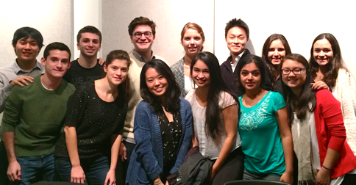
Up Next …
AMSA History & AMSA Today Deb V. Hall, M.D. – National President

Slide 8
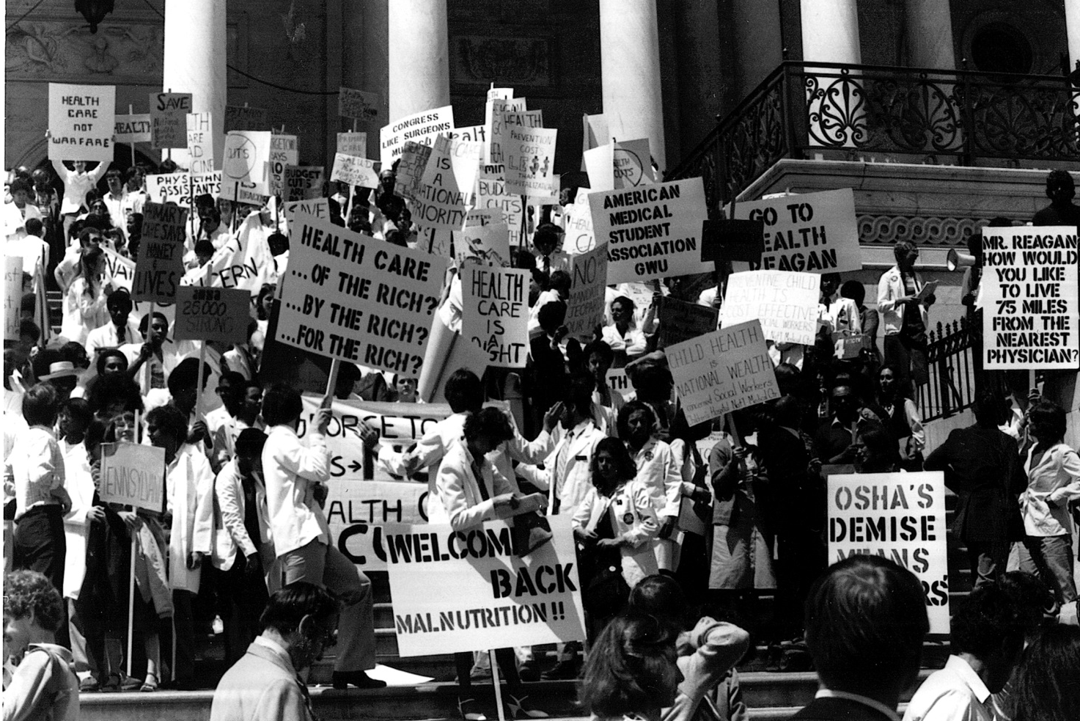
AMSA History
Who are we and how did we get here?

Slide 9
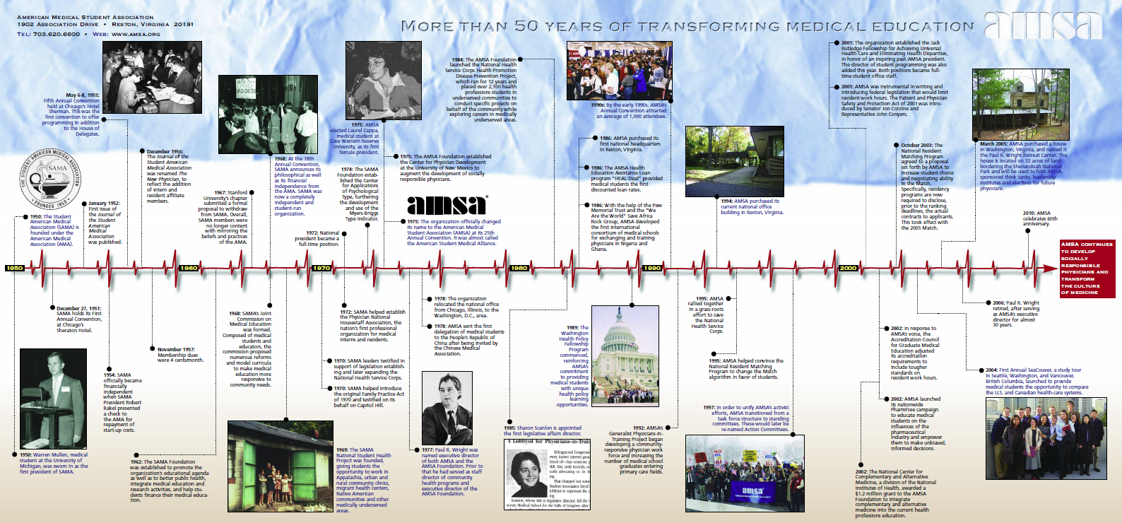
Our History

Slide 10
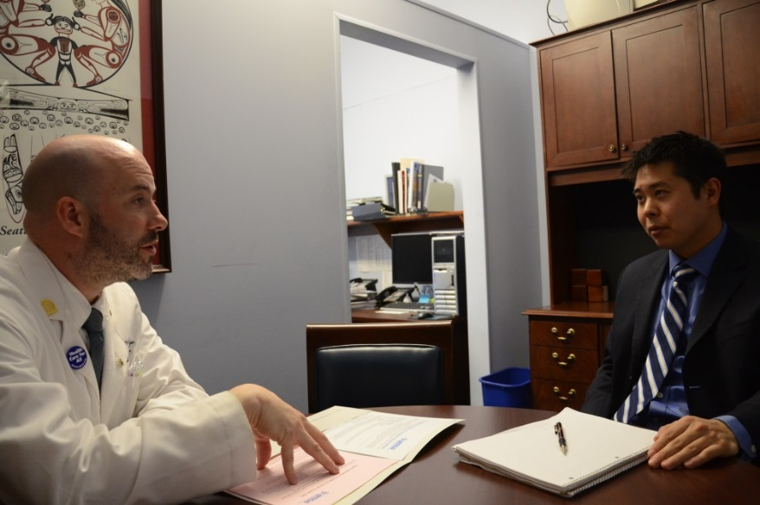
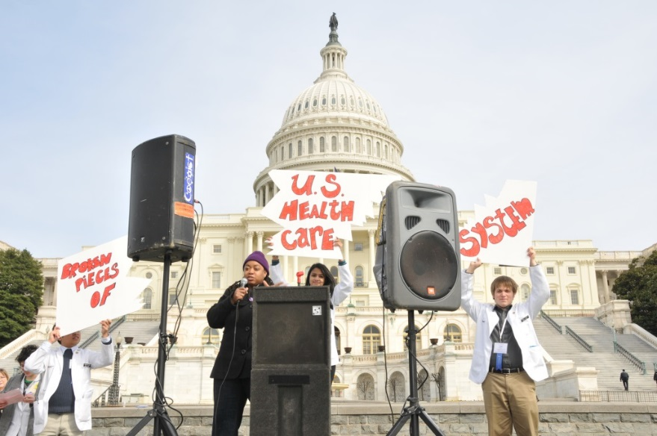
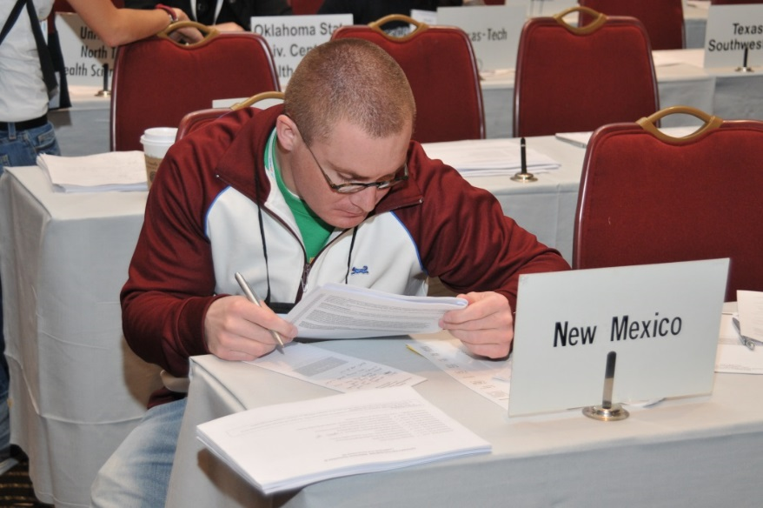
Why AMSA?

Slide 11
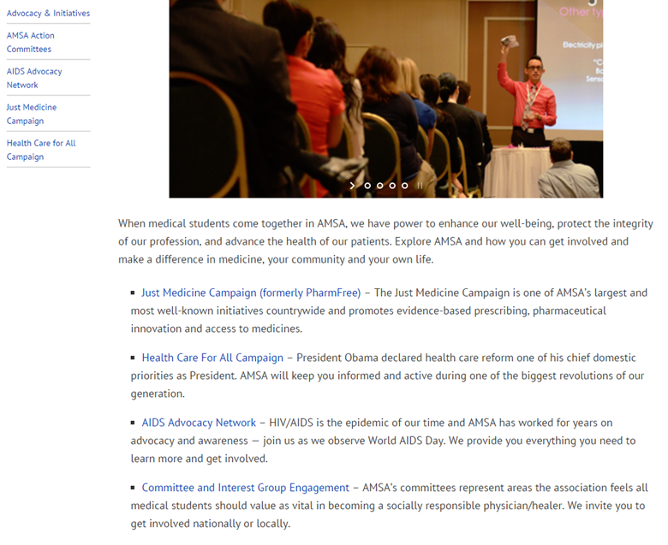
AMSA Today

Slide 12
Where YOU Come In
Our Members
Regional Directors
Chapter Leaders
Officers and Staff

Slide 13
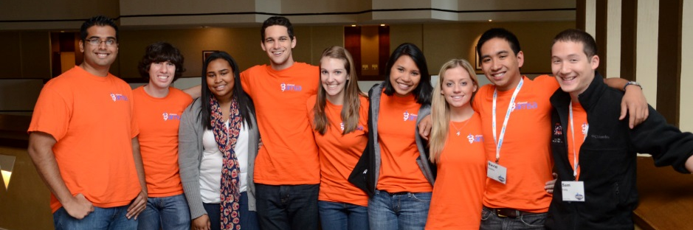
Up Next …
The AMSA Narrative Perry Tsai – VP for Program Development

Slide 14
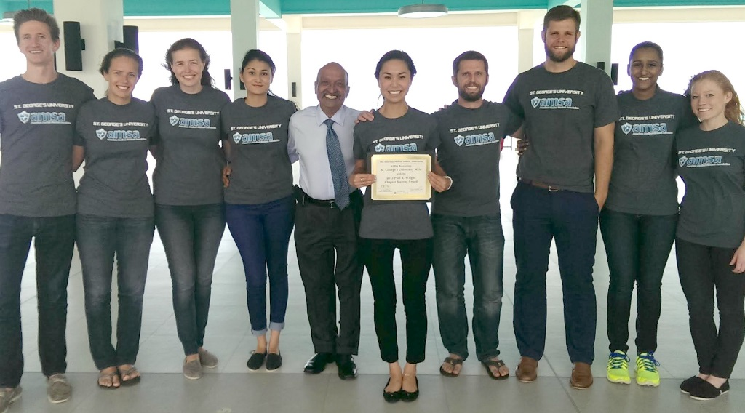
The AMSA Narrative
Meaning
Inspiration
Community
Platform

Slide 15
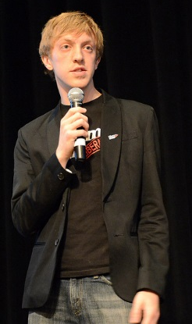
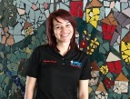
Your AMSA Narrative
What is your AMSA narrative?
What are your goals/passions as a physician-in-training?
What part of AMSA’s mission aligned with those goals and inspired you to join?
How has being a member of AMSA helped you toward those goals?
Listen to other people’s narratives.
What can you learn from others?
How does their narrative fit with yours?
How does their narrative fit with AMSA?
Share your own narrative.

Slide 16
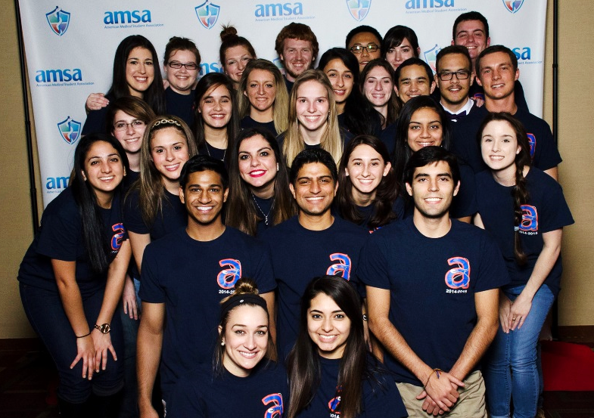
Up Next …
You Are the Face of AMSA Rinku Skaria – VP of Membership https://youtu.be/m2-Srb_R0tY

Slide 17
Chapter Success Stories
https://youtu.be/rhcgt9G4GE8

Slide 18
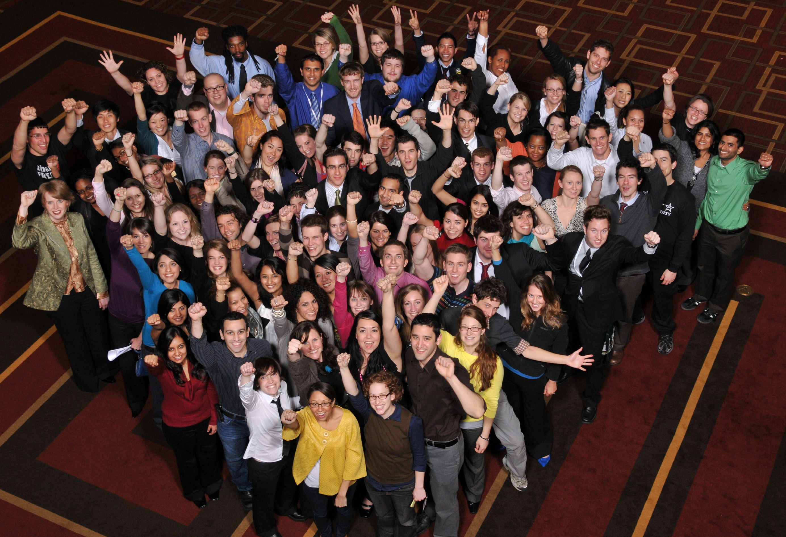
Chapter Success Stories
https://youtu.be/028HPC_uBTc

Slide 19
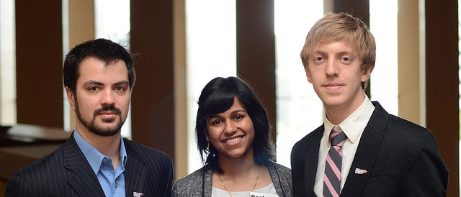
Up Next …
Being a Chapter Officer & Leadership Support Michael Sparks – International Trustee

Slide 20
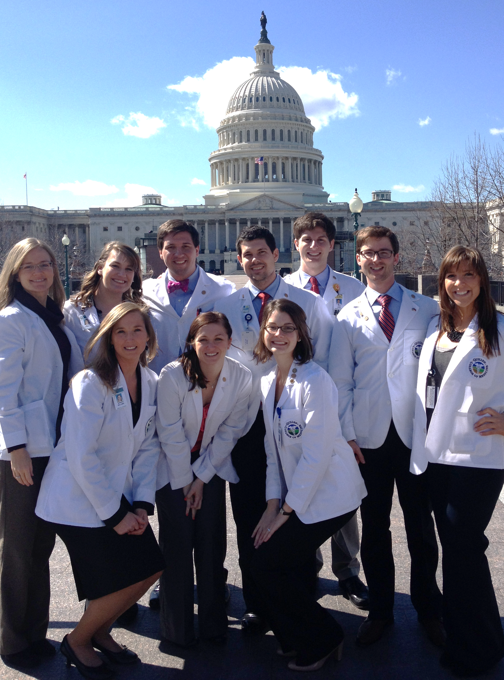
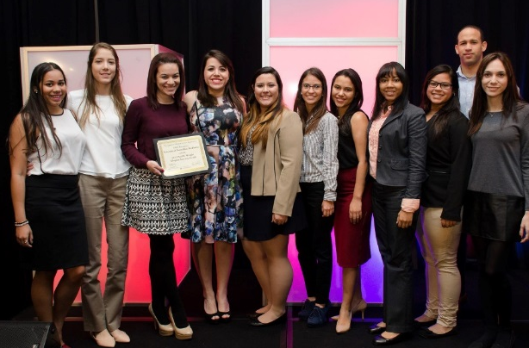
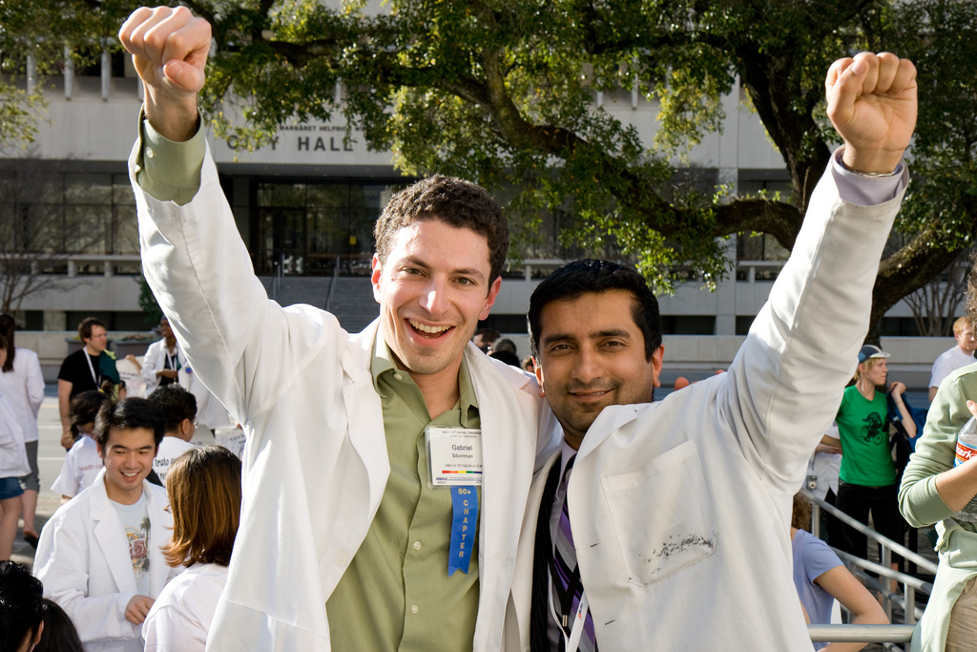
Why is This Important?
Make this year your most successful yet!
How do you do it?
What resources are available to you?

Slide 21
Leadership Structure
Board of Trustees
Regional Directors
Action Committee and Team Chairs
Local Chapter Officers
Staff
Our Members
Regional Directors
Chapter Leaders
Officers and Staff

Slide 22
Regions
5 Domestic Regions
2 International Regions
12 Regional Directors (5 domestic med + 5 premed + 2 international)

Slide 23
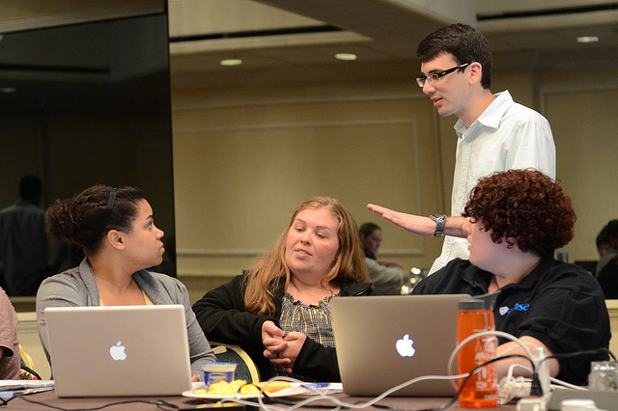
Up Next …
Running Effective Meetings & How to Raise Money Stefanie Smith – Premedical Trustee

Slide 24
Running Effective Meetings
Make sure you market your meeting effectively.
Keep it organized.
Have a way to track attendees.
Start and end on time.
For speaker meetings, make sure the speaker is relevant and your members are interested in what they have to say.

Slide 25
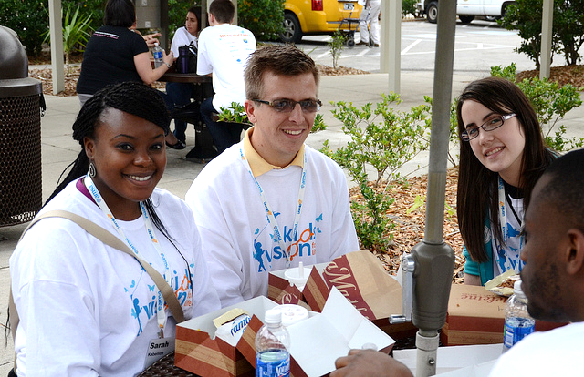
How to Raise Money
Ask student government for money.
Talk to your dean about funding possibilities.
For medical schools – Diagnostic equipment sale.
For premedical schools – Kaplan course auctions.
Tournaments, such as dodgeball, bowling, or classics like bake sales.

Slide 26
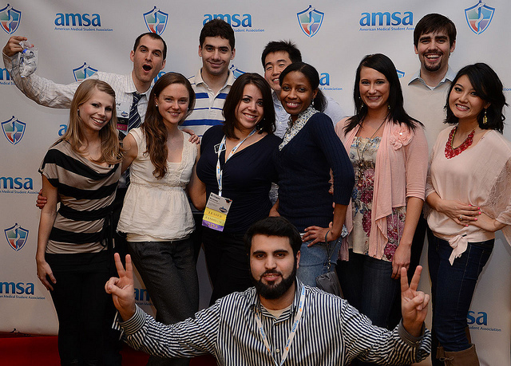
Up Next …
Final Thoughts Jeff Koetje, M.D. – Director of Experiences

Slide 27
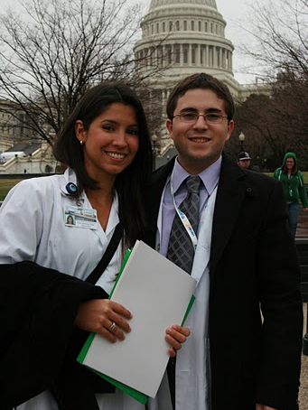
Final Thoughts
AMSA: Your home and training ground.
It takes more than medical school to make a physician.

Slide 28
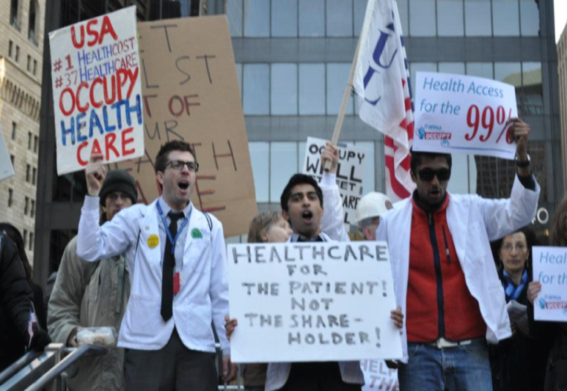
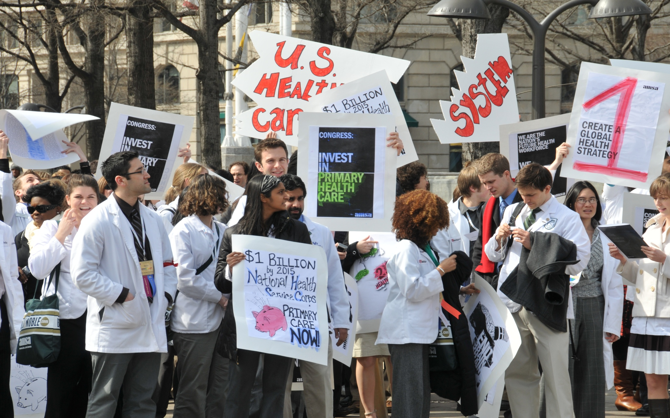
Final Thoughts
Your AMSA Experience is framed by a bold vision.
Education for advocacy.
Advocacy for education.

Slide 29
Final Thoughts
Your AMSA Experience is sustained by a bold mission.
AMSA’s Aspirations:
Quality, Affordable Health Care for All
Global Health Equity
Enriching Medicine Through Diversity
Professional Integrity, Development, and Student Well-Being

Slide 30
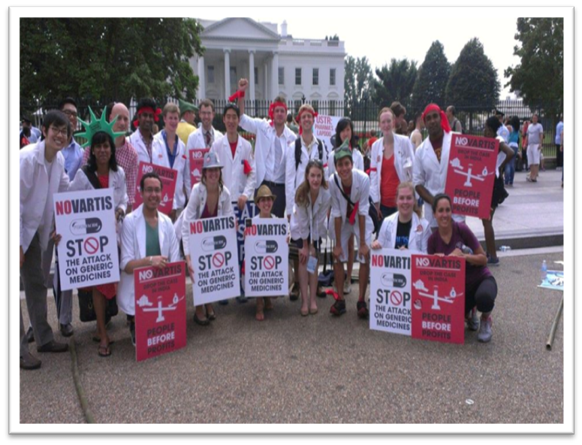
Final Thoughts
AMSA is a home & training ground for bold, visionary, mission-driven
Physicians-in-training, who may also be …
Advocates-in-training
Activists-in-training
Humanists-in-training
Educators-in-training
Professionals-in-training
Leaders-in-training

Slide 31
Thank You!
Closing Remarks Rinku Skaria – VP of Membership https://youtu.be/yDQLULF3I_Q

Slide 32
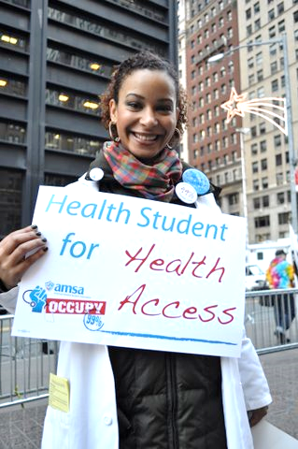
Thank you!
We will stay online a little longer to answer any last minute questions via the chat box.
Otherwise see you tomorrow!

