Slide 1
Access to Medications: An introduction Braveen Ragunanthan Keanan McGonigle Slides prepared by: Alison Case, Education and Advocacy Fellow Katrina Ciraldo, co-chair, AAN Steering Committee Any questions/concerns/feedback: email us at aan.chair@amsa.org

Slide 2
Review from earlier Webinars
What is PEPFAR?
What can we do about it?
What is treatment as prevention?
What can we do about it?
What is harm reduction?
What can we do about it?
Notes:
PEPFAR – appropriations
Treatment as Prevention – promote adoption of WHO guidelines by countries. Educate legislators so they understand why its important to fund PEPFAR/GF
Harm reduction – lobbying to appropriators to end ban, mary beth levin is our support person on this. Also educating our fellow pre-meds and medical students about harm reduction approaches, including syringe exchange and medication-assisted therapies like suboxone and methadone.

Slide 3
Quick word on AAN SP projects
Your project: do an advocacy action of your choosing on one of the topics we’ve addressed (listed below) and write a 1-2 page reflection on the experience, considering the following questions:
What is the role of future physicians in doing advocacy?
What benefit or challenges did the advocacy present to you and how does it relate to your stage of training (pre-med, pre-clinical med, clinical-med)?
Topics: Syringe exchange/harm reduction, US funding for PEPFAR/Global Fund, Access to Medicines/Trans-Pacific Partnership, Tuberculosis, Homelessness and HIV, Criminalization of HIV
Due date is March 30th
We hope to see you all at National Convention

Slide 4
Conflicts of Interest
We do not have any funding from pharmaceutical or other companies
*** History: AMSA led a national campaign to get medical school lecturers to insert a “Second Slide” to disclose conflicts of interests, i.e. if they receive funding from a specific pharmaceutical company, students should know so they can assess bias ***

Slide 5
Roadmap
What Affects Access to Medicines?
Research and Development
Most efficacious, safest, least toxic (also applies to vaccines)
Cost
the drug needs to be affordable
Intellectual property and International trade agreements
The Trans Pacific Partnership
Why this matters and what we can do

Slide 6
Research and Development
Basic research
A lot is done at universities and national labs
Funding from NIH, shrinking budget
Translational research
Translating in-vitro molecules to in-vivo (animal models, humans), developing delivery systems
Often in academic medical centers, but private companies also acquire intellectual property to “develop” it
Clinical research, including clinical trials
Assessing safety and efficacy
Multiple stages, very expensive

Slide 7
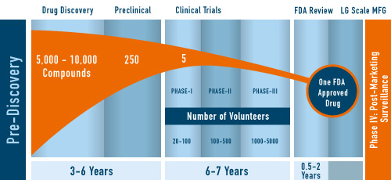
The IP Argument
Tufts Study (funded by PhRMA) - $2.6 bill
MSF - $50 mill & no more than $190 mill
Notes:
Because much (all) data about drug pricing is proprietary, it is difficult to estimate the actual cost of bringing a biomedical product to market. One study by the Tufts Center for the Study of Drug Development found the average cost to be $2.6 bill & this figure is often cited by the industry to justify high drug prices. Conversely, Doctors without Border (MSF) finds that drug discovery, testing, & distribution could occur for ~$50 mill & no more than $190 mill. These are opposite ends of an incredibly wide spectrum, so the truth is likely somewhere between, but this debate highlights the issue of transparency.

Slide 8
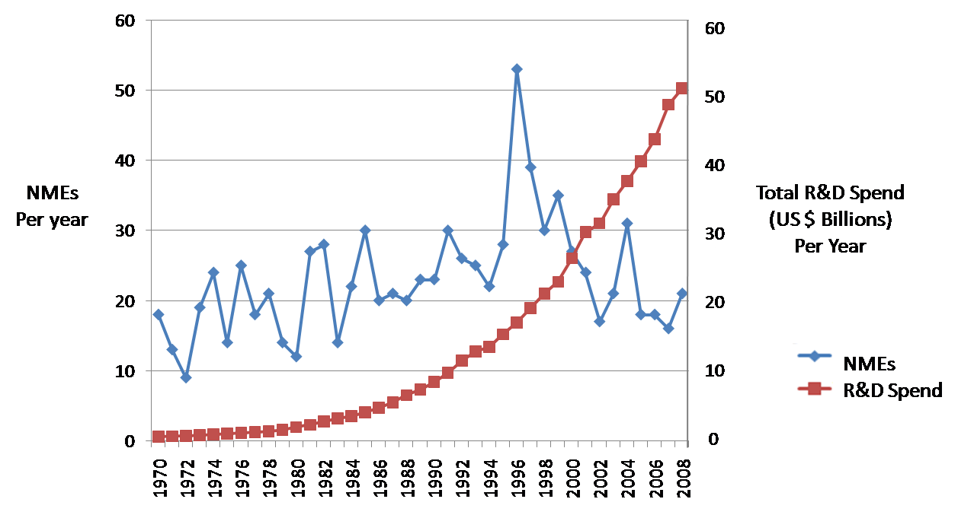
R&D and Cost
Pharmaceutical companies argue that they have to charge high prices in order to fund R & D.
Cost of new drug development is contested.
Marketing and profits account for a very significant portion of pharma expenditures
Patents allow them a monopoly; only they can make and sell the drug while it’s on-patent.
Notes:
Patents are a government-sponsored monopoly – the inventor discloses his/her invention in exchange for the exclusive right to produce it. However, the link between the high returns to drug companies through drug prices and innovation is quite weak! This figure shows that despite exponential growth in R&D, the number of new molecular entities (NMEs), which represent truly novel innovation has flatlined or even decreased. This reflects the outdated model of innovation employed by pharma – pursuing a small subset of target molecules in the pursuit of the next “blockbuster” drug for lifestyle conditions of the Global North.

Slide 9
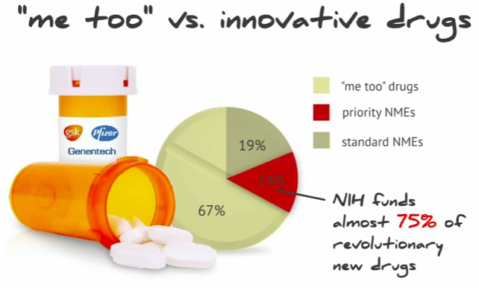
The IP Argument
Notes:
Consumers pay twice for drugs – once through taxes, funding the NIH’s $50+ bill budget and then again at the pharmacy. It is estimated that of those truly novel NMEs, 75% were funded by the NIH in public laboratories or academic medical centers. These discoveries are then licensed to private firms and public investments result in privatized, highly-inequitable returns.
Slide credit to Mariana Mazzucato

Slide 10
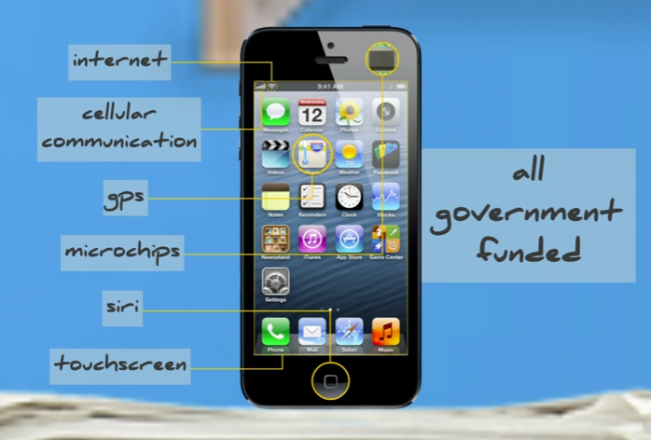
“Privatized returns of public investment”
Notes:
The role of the government as a stable, long term investor in public goods is reflected in this slide from Mariana Mazzucato. Check out her TED talk here: https://www.youtube.com/watch?v=3r1IPsldbBg

Slide 11
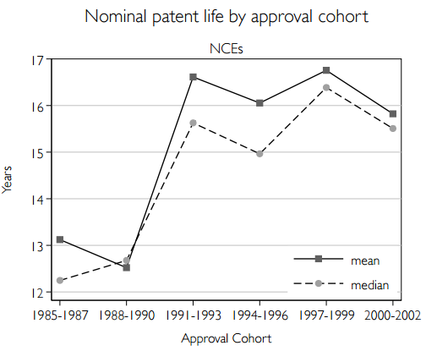
Innovation & Medicine
Since there is no competition among multiple manufacturers, individual pharma companies set the price at whatever they want (consider recent daraprim scandal)
Little-to-no incentive, based on this model, for companies to develop drugs for diseases that affect the global poor; patients/countries can’t afford the high prices
Notes:
Pharma uses patent evergreening to extend the life of their existing patents. Alternatively, firms are moving into the space of buying patents or licenses for older drugs and raising their prices – i.e. in the recent example of “pharma bro” and the HIV / cancer med daraprim. Shkreli was completely within his rights as an investor to do exactly as he did, pointing the flawss in the existing system.

Slide 12
World Trade Organization: TRIPS and Doha
1995 World Trade Organization Agreement on Trade-Related Aspects of Intellectual Property Agreements (TRIPS)
WTO: created to advance the interests of multinational corporations
Countries in the WTO will adopt patent regimes and phase-in honoring patents from other countries, mostly US and Europe
2001 Doha Declaration on TRIPS Agreement and Public Health
Encouraged countries to make use of flexibilities built into TRIPS to issue compulsory licenses to produce generic medications for “public health emergencies” in low-income countries
In 2005, India took advantage of an exemption period for adopting IP protections and amended its Patent Act to incorporate TRIPS flexibilities. India provides 85% of ARVs globally.
India remains under pressure from companies and governments to adopt stricter intellectual property rules
Notes:
So – how are AIDS drugs become available in africa then?
Before TRIPS, countries like india that produce generic drugs did not have to honor the patents from other countries, (most didn’t even have pharmaceutical product patents before TRIPS) so it was legal for them to manufacture a drug, even if it was on patent in the US. Of note, it was ILLEGAL/BANNED for the US to import the drugs as they were still on patent in the US and Europe, so this would be a breech of their monopoly.
With TRIPS, india had to phase in respect for US patents. Because of the Doha declaration, which allows countries to use compulsory licenses to produce low cost medications in public health emergencies

Slide 13
Trade agreements
The US government (representing the interests of pharmaceutical and software industry) has wanted stronger IP protections than WTO achieved through TRIPS
Has used so-called Free Trade Agreements to achieve stricter IP protections for American patents/businesses, often called “TRIPS-plus” provisions
FTAs are negotiated by US Trade Representative and corporate representatives, often in secret and without input from the ministries of health
Easier for the US to get the terms they want when negotiating unilateral agreements or regional agreements with interested countries
Bilateral: US-Chile, US-Morocco, US-Peru
Regional: NAFTA, CAFTA
Multinational: Trans Pacific Partnership
Notes:
An example trips-plus provisions:
Data exclusivity: prohibits use of pharma test data for drug regulatory purposes, which delays the registration/marketing of generic meds
Extension of the patent term for pharm beyond 20 yrs required by TRIPS
Extension of scope of patent protection to allow known substances to be patented for each “new use”
Restrictions on grounds for compulsory license (think – AIDS ok, but cancer, not so much)

Slide 14
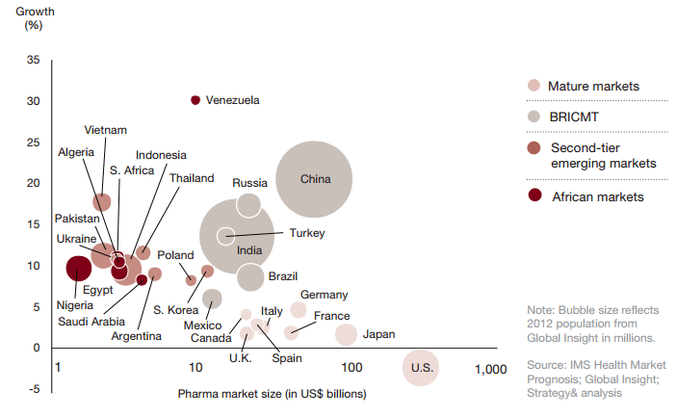
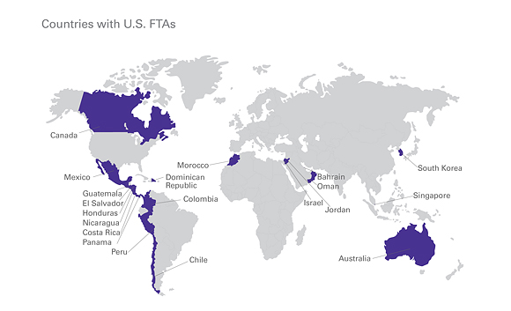
A2M (Cont’d)
Figure 2. Pharma market growth (2011 – 2012) v. pharma market size
Source: Buente et al., 2013
Figure 5. Countries with US FTAs
Source: USTR, 2015
Notes:
Figure 2 is how the pharmaceutical industry looks at the world – the US, despite being a huge market currently, is not expected to grow theat quickly in the future. It is the low-middle income countries (LMICs) like Brazil, India, China, Russia with emerging markets that provide the next market for pharma. So it is absolutely in pharma’s interest to raise the IP standards around the world in order to protect their “investments” and turn a profit. So the industry pushes the US gov into bilateral and now multinational trade agreements in order to export US IP law.

Slide 15
Trans Pacific Partnership
What is it?
Countries involved: US, Australia, Brunei, Chile, Malaysia, New Zealand, Peru, Singapore, Vietnam
Fast track: expedited approval without amendments
Where we are now: The TPP was formally submitted to Congress and there is a 90 day review period, after which Congress can bring it for a vote. It’s currently unclear when they will
Other organizations fighting the TPP:
Labor unions (bad for US job market)
Visit websites:
http://www.citizen.org/access
http://www.flushthetpp.org/
http://www.msfaccess.org/

Slide 16
Why this matters and what we can do
Why does this matter?
Thoughts? Please share!
What can we do?
Ideas? Pledges?
Notes:
Matters:
Scale up for ART – and lifelong therapy. Need to ensure drugs will be affordable.
Drugs for other diseases are unaffordable
Will affect access to drugs in the US as well!
What to do:
Educate lawmakers on agreement’s effect on access to medicines
- leg visit and/or op-ed calling on them to do more
Urge/pressure lawmakers to come out against the agreement and vote against it
Educate our peers at school and ask them to take action

Slide 17
Discussion and Wrap-up

