Slide 1
Cause for pause Scientific Research on Fracking’s Health Risks
Ann alexander, senior attorney, nrdc
American medical students association ● climate change weeK
oCTOBER 5, 2015

Slide 2
Overview of fracking public health risks
Scientific research documenting potential risks
Policy recommendations to address the risk

Slide 3
Who we are
Staff:
Close to 500, mix
of scientists, attorneys, policy advocates
Members and online activists:
2 million +
Issues and priorities:
Climate change
Green energy
Oceans
Wildlife/wild places
Preventing pollution
Water
Sustainable
Communities
Offices:
New York, Washington
DC, San Francisco, Santa Monica, Chicago, Beijing

Slide 4
Fracking overview
Air emissions
Depletion of water resources
Hazardous chemicals; industry seeks trade secret protection
Leaks from disposal wells; impact on sewage treatment plants; seismicity
Leaks, spills, volatilization
Out-of-zone fractures, disturbance of pollutants

Slide 5
Health risks: who is concerned
The National Institute for Occupational Safety and Health (NIOSH)
National Environmental Public Health Tracking Network
Notes:
Industrial activity that occurs close to people’s homes. We know there are some risks associated with industrial activity. Zoning isolates people from nuisances.

Slide 6
Areas of concern
Air Quality
Diesel Particulate Matter (PM) (respiratory and cardiovascular)
Ozone (respiratory)
Air Toxics (respiratory, neurological and immune system, carcinogens)
Silica (lung disease)
Noise & Light Pollution
(Sleep disturbances, cardiovascular impacts)
Public Safety
Accidents, Explosions,
Fires, Seismicity
Water and Soil Contamination
Spills, Leaks, Chemical Migration, and Waste Disposal
Methane in Drinking Water (explosive & asphyxiation hazard)

Slide 7
Air quality studies
Human health risk assessment of air emissions from development
of unconventional natural gas resources
Lisa M. McKenzie, Roxana Z. Witter, Lee S. Newman, John L. Adgate (2012)
Cancer risk from VOCs
Highly elevated atmospheric levels of volatile organic compounds in the Uintah Basin, Utah.
Helmig D, Thompson CR, Evans J, Boylan P, Hueber J, Park JH.(2014)
Levels of VOCs
Source signature of volatile organic compounds (VOCs) from oil and natural gas operations in northeastern Colorado
Gilman, Jessica, Brian M. Lerner, William C. Kuster, and Joost de Gouw (2013)
Source of VOCs
A new look at methane and non-methane hydrocarbon emissions from oil and
natural gas operations in the Colorado Denver-Julesburg Basin
Petron et al. (2014)
Levels of VOCs
Impact of Natural Gas Extraction on PAH Levels in Ambient Air
Paulik, L.B., Carey E. Donald, Brian W. Smith, Lane G. Tidwell, Kevin A. Hobbie,
Laurel Kincl, Erin N. Haynes, and Kim A. Anderson. (2015)
Cancer risk from PAHs
Air concentrations of volatile compounds near oil and gas production: a community-based exploratory study
Macey, Gregg P., Ruth Breech, Mark Chemaik, Caroline Cox, Denny Larson, Deb
Thomas, and David O. Carpenter (2014)
Levels of VOCs/H₂S
Influence of oil and gas field operation on spatial and temporal distributions of atmospheric non-methane hydrocarbons and their effect on ozone formation
in winter
Field, R.A., J. Soltis, M.C. McCarthy, S. Murphy, D.C. Montagu. (2015)
Source of VOCs
Associations of Short-Term Exposure to Ozone and Respiratory Outpatient
Clinic Visits — Sublette County, Wyoming, 2008–2011
Wyoming Dep’t of Public Health (2013)
O₃ impacts

Slide 8
Air quality studies: key findings
Presence of proximate air toxics:
Levels of benzene and H₂S in proximity to operations (> 150m CO setback distance) exceeding levels in major urban areas
Inventories underestimated benzene emissions 4-9X
Source of air pollution:
Source signatures indicate oil and gas production is a primary source of wintertime regional O₃ production
Source signatures indicate elevated PAH levels at nearby properties (.04-3.2 miles) are associated with gas extraction
Health impact of proximate air pollution:
Elevated cancer risk in proximity (.5 miles) to wells, associated with VOCs
Elevated respiratory health care visits during ozone spikes in rural Wyoming (which exceeded LA basin spike levels)
Lifetime cancer risk of proximate PAH exposure > 2.9/10,000
Lifetime cancer risk of proximate formaldehyde exposure > 1/10,000
Levels of benzene, H₂S in proximity exceeding CDC/ATSDR risk levels

Slide 9
Air quality studies: what we already know
Table 2: Health impacts of the main air pollutants by target organ and system
Pollutant | Target organ/system | carcinogen
Particulate matter (Pm)
Diesel pM | Respiratory system; Cardiovascular system | •
pM10 and smaller | Respiratory system; Cardiovascular system
volatile organic compounds (vocs)
Benzene | Immune system; Blood; Fetal development, Nervous System | •
Toluene | Brain and nervous system; Respiratory system; Fetal and child development; Reproductive system
Ethylbenzene | Fetal and child development; Liver; Kidney; Endocrine system; auditory system | •
Xylene | Brain and nervous system; Fetal and child development
Other VOCs (incl. Formaldehyde, Methanol) | Immune system; Respiratory system; Brain and nervous system; Fetal and child development; Liver; Kidney; Endocrine system | •
other
Hydrogen sulfide (H2S) | Respiratory system; Brain and nervous system; Gastrointestinal system
NOx | Respiratory system
Ozone (O3) | Respiratory system; Cardiovascular system
Respirable Silica | Respiratory system; Kidneys; Immune system | •
paHs (incl. Naphthalene) | Immune system*, Reproductive system*; Brain and nervous system*; Developmental effects* | •**

Slide 10
Birth outcome studies
Perinatal Outcomes and Unconventional Natural Gas Operations in Southwest Pennsylvania
Shaina L. Stacy, LuAnn L. Brink, Jacob C. Larkin, Yoel Sadovsky, Bernard D. Goldstein, Bruce R. Pitt, Evelyn O. Talbott (2015)
Birth weight
Birth Outcomes and Maternal Residential Proximity to Natural Gas Development in Rural Colorado
McKenzie, Lisa M., Ruixin Guo, Roxana Z. Witter, David A. Savitz, Lee S. Newman, and John L. Adgate (2014)
Birth defects
Princeton/Columbia/MIT study
Janet Currie, Katherine Meckel, John Deutch. and Michael Greenstone (2014)
Birth weight,
Apgar scores

Slide 11
Birth outcome studies: key findings
McKenzie study: Frequency of congenital heart defects and possibly neural tube defects (but not oral clefts, preterm birth, and low birth weight) associated with well density.
Controlled for demographic, education, and behavioral information available in the vital records
Stacy study: Frequency of low birth weight and small for gestational age associated with degree of maternal exposure.
Controlled for age, education, smoking history, WIC assistance, gestational diabetes, prenatal visits, pre-pregnancy weight, child’s gestational age, child’s gender
Currie study: Maternal proximity increased the likelihood of low birth weight from ~ 5.6 % to >9%; and roughly doubled the chances of a low Apgar score to ~5%
Controlled for, inter alia, geographical differences in mothers' initial health characteristics, private vs. public water supply
No correlation with drinking water exposure

Slide 12
Water quality studies
Methane contamination of drinking water accompanying gas-well drilling and hydraulic fracturing
Osborn, Stephen G., Avner Vengosh, Nathaniel R. Warner, and Robert B. Jackson (2011)
Methane concentrations
The effects of shale gas exploration and hydraulic fracturing on the quality of water resources in the United States
Vengosh, Avner, Nathaniel Warner, Rob Jackson, and Tom Darrah (2013)
Migration pathways;
methane concentrations
Estrogen and Androgen Receptor Activities of Hydraulic Fracturing Chemicals and Surface and Ground Water in a Drilling-Dense Region
Kassotis, Christopher D., Donald E. Tillitt, J. Wade Davis, Annette M. Hormann, and Susan C. Nagel. (2014)
Levels of endocrine
disruptors
An Evaluation of Water Quality in Private Drinking Water Wells Near Natural Gas Extraction Sites in the Barnett Shale Formation
Fontenot, Brian E., Laura R. Hunt, Zacariah L Hildenbrand., Doug D. Carlton Jr., Hyppolite Oka, Jayme L Walton., Dan Hopkins, et al. (2013)
Levels of TDS, arsenic,
selenium, strontium…
Analysis of BTEX Groundwater Concentrations from Surface Spills Associated with Hydraulic Fracturing Operations
Gross, Sherilyn A., Heather J. Avens, Amber M. Banducci, Jennifer Sahmel, Julie M. Panko, and Brooke E. Tvermoes (2013)
Levels of BTEX
associated with spills
Assessment of the Potential Impacts of Hydraulic Fracturing for Oil and Gas on Drinking Water Resources (US EPA External Review Draft) (2015)
Systemic water impacts

Slide 13
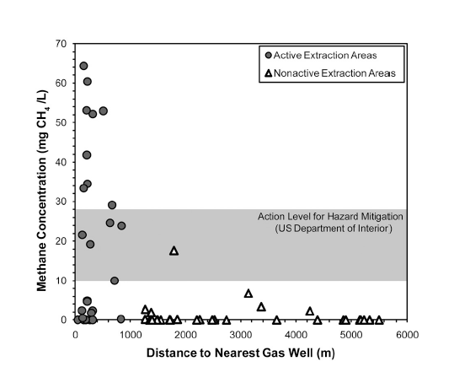
Water quality studies: key findings
Methane migration:
Groundwater contamination:
Proximate groundwater sampling revealed greater incidence of androgens and estrogens
Private well samples exceeding MCLs for TDS, arsenic, selenium, strontium, and barium increased with proximity
BTEX levels elevated near spills, but can be reduced via remediation
Systemic impacts:
EPA: “Specific instances” of impacts, but no evidence of “widespread, systemic impacts” on drinking water resources
In active extraction areas (1+ wells within 1 km), average and max methane concentrations in drinking water wells increased with proximity
Levels of methane were a potential explosion hazard
Elevated shallow groundwater methane in proximity linked to wells
Migration pathways exist between shallow and deep groundwater

Slide 14
Public and occupational safety
Shale gas development linked to traffic accidents in Pennsylvania
Muehlenbachs, L.; Krupnick, A. J. (2013)
Traffic accidents (community)
Motor vehicle fatalities among oil and gas extraction workers
Retzer, K. D.; Hill, R. D.; Pratt, S. G. (2013)
Traffic fatalities
(workers)
Occupational exposures to respirable crystalline silica during hydraulic fracturing
Esswein, Eric J, Michael Breitenstein, John Snawder, Max Kiefer, and W Karl Sieber (2013)
Silica exposure
(workers)
The 2001–Present Induced Earthquake Sequence in the Raton Basin of Northern New Mexico and Southern Colorado
Justin L. Rubinstein, William L. Ellsworth, Arthur McGarr and Harley M. Benz (2014)
Seismicity/
injection link (CO)
Oklahoma’s recent earthquakes and saltwater disposal
F. Rall Walsh III and Mark D. Zoback (2015)
Seismicity/
injection link (OK)
Earthquakes Induced by Hydraulic Fracturing in Poland Township, Ohio
Robert J. Skoumal, Michael R. Brudzinski, and Brian S. Currie (2015)
Seismicity/
fracturing link (OH)
Earthquake hypocenters and focal mechanisms in central Oklahoma reveal a complex system of reactivated subsurface strike-slip faulting
D. E. McNamara, H. M. Benz, R. B. Herrmann, E. A. Bergman, P. Earle, A. Holland, R. Baldwin, A. Gassner (2015)
Risk of larger
quakes (OK)

Slide 15
Public and occupational safety: key findings
Traffic accidents:
1 additional well drilled per month increase truck accident frequency in counties by > 2%
Worker safety:
Motor vehicle fatality rate in hydraulic fracturing industry 8.5X that of all private wage and salary workers
Gas industry has fatality rate 2 ½ X construction industry, 7X general industry rate
Seismicity
Injection correlates with seismicity in CO, OK
Hydraulic fracturing correlates with seismicity in OH
Injection-induced seismicity “increased the probability for a damaging earthquake”

Slide 16
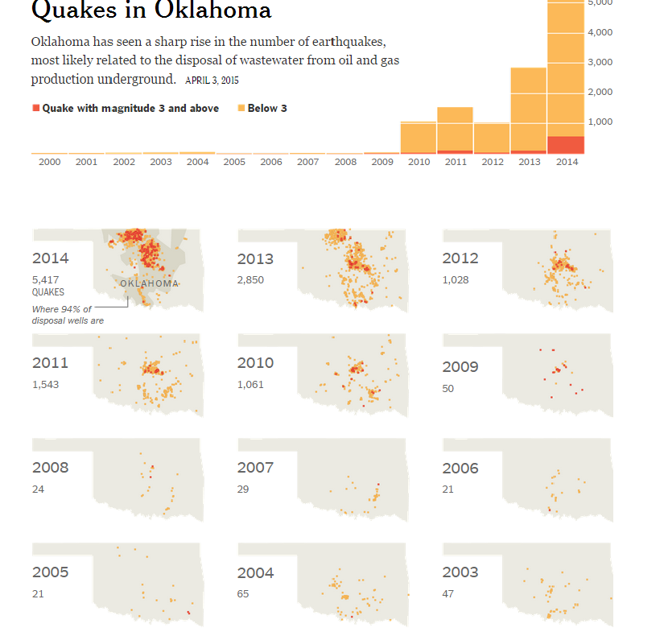
Oklahoma seismicity data (NYT/OK Geophysical Survey)

Slide 17
Chemicals used in fracking
: key findings
Natural Gas Operations from a Public Health Perspective
T. Colborn, D. Kwiatkowski, K. Schultz, and M. Bachran (2011)
Reviewed 944 (non-trade secret protected) products containing 632 chemicals
75% could affect skin, eyes, and respiratory and gastrointestinal systems.
~40–50% could affect the brain/nervous system, immune and cardiovascular systems, and kidneys
37% could affect the endocrine system
25% could cause cancer and mutations
Reviewed 2,500 (mostly non-trade secret protected) products, 750 chemicals
29 chemicals, in 650 products, are either:
Known or possible carcinogens
Regulated under the Safe Drinking Water Act for risks to human health, or
Listed as hazardous air pollutants under the Clean Air Act
Potential effects
Chemicals Used in Hydraulic Fracturing
House of Representatives, Energy and Commerce Cmte. Minority Staff (2011)
Potential effects

Slide 18
Disclosure to health professionals: the big chill
State trade secret laws allow companies to keep chemical identities secret.
Limited disclosure to health professionals
Restrictive and vague re-disclosure provisions create conflicting obligations.

Slide 19
Overall health indicia
Unconventional Gas and Oil Drilling Is Associated with Increased Hospital Utilization Rates
Thomas Jemielita, George L. Gerton, Matthew Neidell , Steven Chillrud , Beizhan Yan , Martin
Stute , Marilyn Howarth , Pouné Saberi , Nicholas Fausti , Trevor M. Penning , Jason Roy , Kathleen J. Propert , Reynold A. Panettieri, Jr (2015)
Hospitalizations

Slide 20
Overall health indicia: key findings
Unconventional Gas and Oil Drilling Is Associated with Increased Hospital Utilization Rates
Thomas Jemielita, George L. Gerton, Matthew Neidell , Steven Chillrud , Beizhan Yan , Martin
Stute , Marilyn Howarth , Pouné Saberi , Nicholas Fausti , Trevor M. Penning , Jason Roy , Kathleen J. Propert , Reynold A. Panettieri, Jr (2015)
Findings:
Hospitalizations for heart conditions, neurological illness, skin conditions, cancer, and urologic problems associated with well density.
Example: well density > .79/km² associated with an excess 9.51 inpatient admissions for heart conditions within a zip code
Method:
Used databases that contained over 198,000 hospitalizations from 2007-2011
Compared inpatient hospitalization rates against wells per zip code and per km²
Limitations (self-identified):
Zip code analysis is less precise than evaluating individuals
Identifies association only not causation
Hospitalizations

Slide 21
What we know: ongoing research raises concerns
Air quality:
Evidence: Fracturing contributes to locally harmful levels of air toxics, O₃ precursors
What we don’t know: What are the on-site sources of these pollutants? What are the actual impacts on public health? Can they be mitigated?
Birth outcomes:
Evidence: Proximity to O&G operations associated with adverse birth outcomes
What we don’t know: Does the association signify causation? If so, what is the specific cause and mode of exposure?
Water quality:
Evidence: Documentation of migration pathways, correlation with local contamination
What we don’t know: Causation, frequency, severity, public health impacts
Seismicity:
Evidence: Injection and possibly fracturing have caused low-level seismicity
What we don’t know: Is there potential for more severe induced seismicity? Why some places and not others?

Slide 22
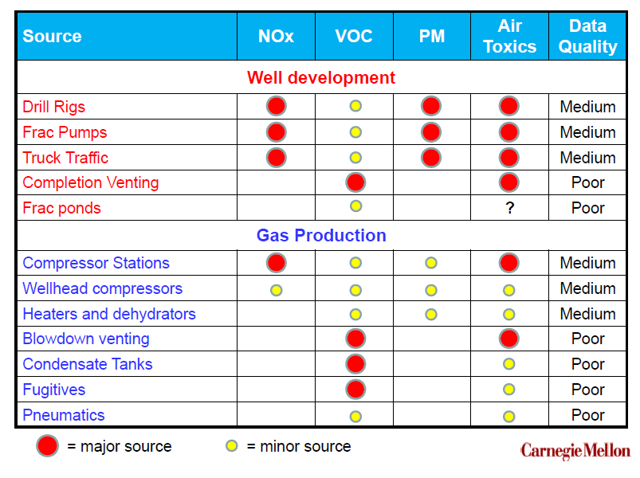
Data uncertainty: air pollution sources

Slide 23
Precautionary principle
“If an action has a suspected risk of causing harm, in the absence of scientific consensus that the action is not harmful, the burden of proof that it is not harmful falls on those taking an action.”

Slide 24
NRDC policy position
“Unconventional development using advanced fracking methods poses threats to water, air, land, and the health of communities.”
“NRDC supports moratoria on fracking to give states and communities time to fully evaluate the risks and determine whether it's possible -- and if so, how -- to protect against them.”
“Where moratoria are not in place, we are also fighting for state and federal safeguards…”
“Communities should have the right to protect themselves when their state and federal governments fail them…”

Slide 25
Some policy recommendations
Moratorium until more is known about risks and ability to mitigate them.
Heightened air emissions controls: address both flowback and fugitive emissions from all sources
Larger setbacks: should be based on emerging air quality research
Transparency: end trade secret protection of additives, require extensive application information and full reporting
Discretion to protect public health: agency authority to deny permits that may not be protective despite compliance
Robust enforcement: includes both sufficient agency resources and public rights to challenge permits and bring citizen suits
Presumption of liability: reverse the burden of proof for water contamination
Collection of baseline data: mandatory pre- and post-frac testing
Federal regulatory programs: an end to exemptions for oil and gas
Community self-determination: communities should retain traditional authority to limit, zone, and prohibit risky activities within their borders

Slide 26
Thank you
questions?

Slide 27
moving forward on Methane: Climate and Health Benefits from Cleaning Up the Oil and Gas Industry
Meleah Geertsma, J.D., M.P.H.
senior attorney, nrdc
American medical students association ● climate change weeK
oCTOBER 5, 2015

Slide 28
NRDC’s Climate and Clean Air Program
Lawyers, scientists, policy analysts, etc. focused on reducing greenhouse gases and other air pollutants in the U.S. and internationally
Priority: cleaning up and transforming the power sector by moving away from dirty fossil fuels

Slide 29
Health Impacts from Climate Change
National Climate Assessment (http://nca2014.globalchange.gov/report/sectors/human-health#intro-section-2 )
Air Pollution
Allergens
Wildfires
Temperature Extremes
Precipitation Extremes
Vector-borne Diseases
Food- and Waterborne Diarrheal Disease
Food Security
Mental Health and Stress-Related Disorders
For more: see Kim Knowlton’s blog, http://switchboard.nrdc.org/blogs/kknowlton/
Notes:
Air pollution: ozone and/or particulate matter, linked to asthma as well as respiratory and cardiac impacts
Allergens - higher pollen concentrations and longer pollen seasons from longer warm weather periods, along with increased indoor mold and fungi from wetter conditions
Wildfires – range of air pollutants
Temp extremes - – heat waves leading to deaths from heat stroke, cardiovascular disease, respiratory disease, and cerebrovascular disease
Precipitation extremes - flooding leading to drowning and mold-related illnesses; drought leading to wildfires, dust storms, extreme heat events, flash flooding, etc.
Vector-borne disease - adaptation and shifts in range of carriers
Food and waterborne diarrheal disease – disease transmission impacted by air and water temps, precipitation patterns, extreme rainfall, and seasonal variations.
Food Security – specific diets (Native American) disrupted; higher prices for food; nutritional value declines
Mental health and stress-related disorders – among those already battling them and those without previous issues. Other stress-related outcomes like low birth weight.

Slide 30
Overview of the Gas Industry
Notes:
Most attention re fracking is focused on well sites; I’ll be talking about the oil and gas sector broadly speaking for methane purposes.

Slide 31
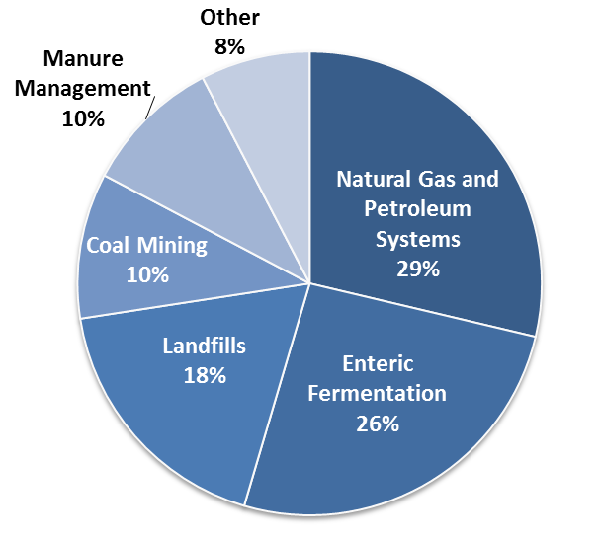
Overview of Methane Pollution
Notes:
Methane accounts for about 10% of US GHGs, of which about a third comes from the oil and gas sector. In turn, nearly 50% of the sector’s methane pollution comes from production sources; the remainder comes from gas processing, transmission and storage, and distribution.

Slide 32
Climate Change and the Oil and Gas Industry
Methane is a highly potent greenhouse gas, with about 85 times the warming potential of CO₂ on a 20-year basis and about 35 times on a 100-year basis.
The oil and gas sector is the country’s second largest industrial contributor to climate change, after power plants, due to its methane pollution problem.
The sector emits close to 8 million tons of methane each year.
That’s enough gas to heat about 6 million homes per year.

Slide 33
Other Air Pollutants from Oil and Gas Industry
Volatile Organic Compounds > ozone > respiratory impacts
Hazardous Air Pollutants, e.g., benzene and H₂S > eye/nose/respiratory irritation, headaches, fatigue, dizziness, cancer, blood disorders
Found throughout the sector, though in varying amounts, typically with higher levels seen upstream of gas processing plants
Co-emitted with methane, so controls for methane will reduce VOCs and HAPs to some extent as well
Notes:
As discussed by Ann.

Slide 34
Sources of Methane
Leaks. Can be large or small; ubiquitous and hard to predict.
Compressors and Pneumatic Devices. Used to move gas throughout the system.
Well Completions. “Whoosh” of gases following hydraulic fracturing.
Tanks. Throughout the system.
Liquids Unloading. Process of removing accumulated liquids from an existing well to restore/increase production.
Others.

Slide 35
Controls for Methane from Oil and Gas Operations
Using the below measures, NRDC and our colleagues have estimated that we can control 40-50% of the sector’s methane problem in a few years, at a low cost to industry.
(See Waste Not report, http://docs.nrdc.org/energy/files/ene_14111901a.pdf)
Leak Detection and Repair (LDAR) programs
Low Bleed/Emission Rate Equipment Design
“Green” Completions or Reduced Emission Completions
Proper Tank Design and Maintenance
Capture and Reuse
Plunger Lifts and other similar techniques
Notes:
Basic idea is to prevent leaking and venting, and to capture and reuse as much gas as possible. Flaring is a control for methane, but produces other harmful gases.
Many of these measures pay for themselves in a short while, because they help keep product in the system that can then be resold.

Slide 36
Clean Air Act Section 111
Precautionary Principle: EPA Administrator lists categories of industrial sources based on a determination that they “cause[ ], or contribute[ ] significantly to, air pollution which may reasonably be anticipated to endanger public health or welfare”
EPA then sets “standards of performance” for new and modified sources of pollution in each category.
Section 111 also requires EPA to address existing sources of pollution from listed categories by issuing emissions guidelines, which states then implement.
Following Massachusetts v. EPA Supreme Court decision, there has been a cascade of legal and regulatory events making clear that greenhouse gases qualify for regulation under Section 111.
EPA proposed its Clean Power Plan under Section 111’s provision regarding existing sources.

Slide 37
Cleaning Up Methane from Oil and Gas
In 2012, EPA finalized standards for VOCs from the oil and gas sector after several decades of delay.
Most notably a requirement to use “green completions” for hydraulically fractured gas wells.
Estimated to eliminate 1 to 1.7 million tons of methane, with approximately $440 million in climate benefits, along with significant reductions in VOCs and HAPs.
EPA did NOT commit to adopting methane standards.
NGO community and others continued their campaign for federal methane standards to reach the remaining sources of methane, which make up the majority of the sector’s methane problem.
In March 2014, the White House announced its Methane Strategy, outlining a number of steps that federal agencies would take to address methane. Key was the beginning of EPA’s process for setting methane standards.

Slide 38
Cleaning Up Methane from Oil and Gas (Cont.)
In April 2014, EPA released white papers detailing methane emissions from oil and gas sources, and ways to control them.
In January 2015, the White House announced a commitment to reduce methane from the oil and gas sector by 40-45% from 2012 levels by 2025, including EPA standards for methane from new and modified sources, along with several other actions. The announcement did NOT commit to adopting emission guidelines for existing sources of methane.
In August 2015, EPA proposed the methane standards for new and modified oil and gas sources. Standards are based on the controls discussed earlier, and will achieve some VOC and HAP reductions.

Slide 39
Thank you
questions?

